Slide 1
Bekir Mugayitoglu, MBA
Learn to code, code to learn

Slide 2
The use of media in the classroom engages students and motivates their interest in the content.
Mateer (2012)

Slide 3
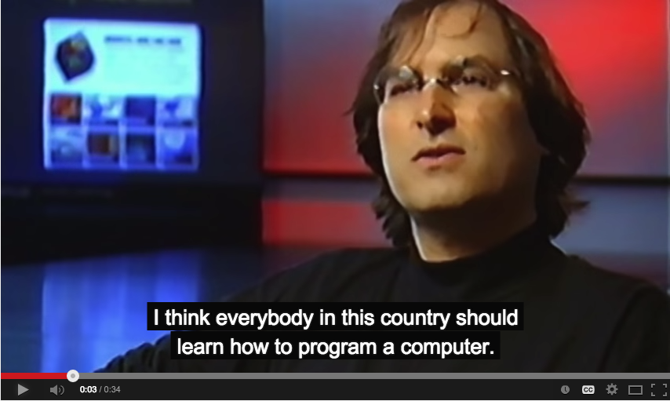
Steve jobs

Slide 4
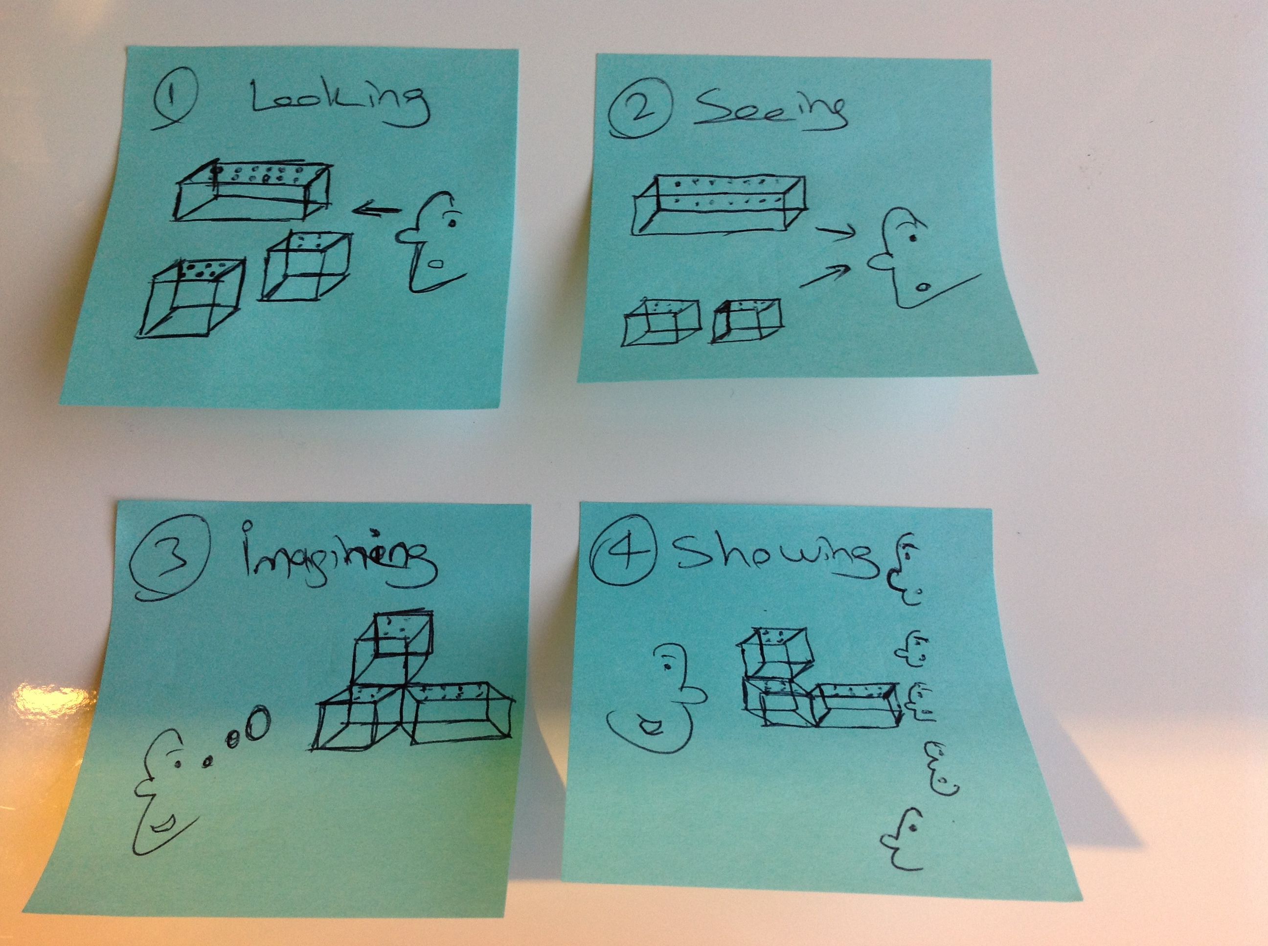

Slide 5
What is programming language?

Slide 6



What do people do with computers?

Slide 7
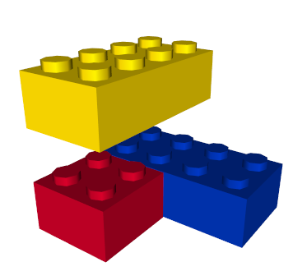
Lego

Slide 8
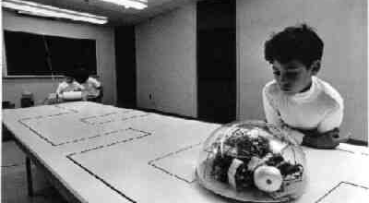
Logo

Slide 9
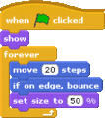
Scratch computer programming language

Slide 10
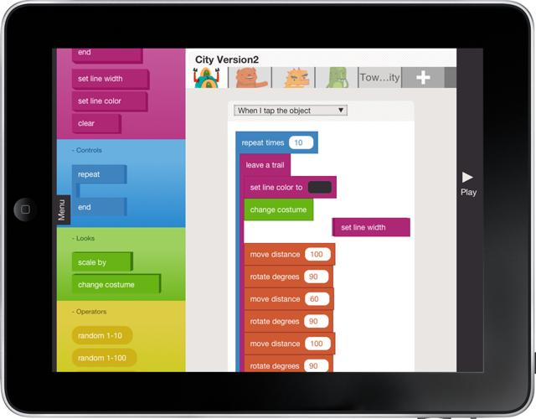
Hopscotch iPad programming language

Slide 11
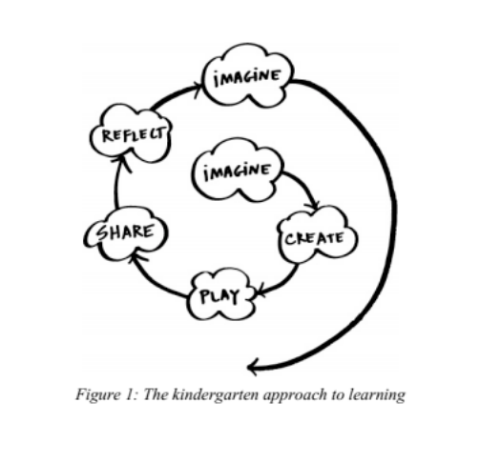

Slide 12
PRINCIPLES
4 Principles
Creating
Personalizing
Sharing
Reflecting

Slide 13
Computational thinking
Computational thinking concepts
Computational thinking practices
Computational thinking perspectives

Slide 14
Contents
Reading
Math
Social science
Music
Art
Science

Slide 15
http://www.gethopscotch.com/
http://scratch.mit.edu/
http://studio.code.org/s/course2/stage/4/puzzle/9
http://studio.code.org/s/course1/stage/11/puzzle/8
http://studio.code.org/s/course1/stage/5/puzzle/3

