Slide 1
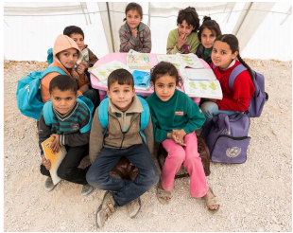
Education for Syrian children Refugees in Turkey
Notes:
Children and war
School, community and family

Slide 2
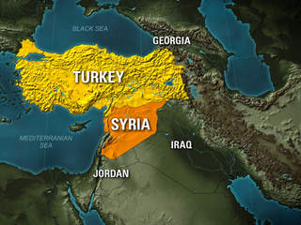
War
Notes:
An estimated 700,000 Syrian refugees have poured into Turkey since the start of the Syrian war.
The United Nations High Commissioner for Refugees (UNHCR) estimates that of the one million Syrians that will reside in Turkey in 2014, 795,000 will be children, half-a-million of whom will be of school-going age.

Slide 3
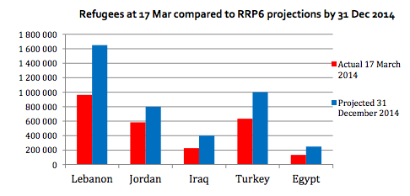
Refugees in neighbor countries
Notes:
On April 29, 2011, the first Syrian refugees crossed the border into Turkey. Two years later, the country hosts some 700,000 Syrian refugees—200,000 of them living in 21 refugee camps
Many refugees have benefited from Turkey’s “temporary protection” policy and have received services ranging from food and shelter to education in camps along the border.
In camps, the government partners with UNHCR and UNICEF to provide educational services. Many Syrian children have lost between one and three years of education. In 2012 and 2013, only 60 percent of primary school-aged boys and girls in Turkish camps were enrolled in school. Additionally, UNHCR reports that there are some vocational training courses, language courses, or extra-curricular activities offered in Turkish camps.

Slide 4
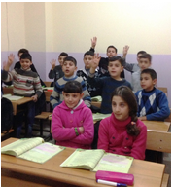
Non-camps services
Notes:
While there is still more to be done in camps, non-camp services are also critical. Many more children are residing in host communities than in camps in Turkey. In 2014, UNHCR expects 159,000 children to reside in camps, compared to 636,000 in host communities. Despite the size of this population in need, only 14 percent of primary school aged children outside of camps are enrolled in school in Turkey. Outside of camps, families struggle to find free schools that offer Arabic language instruction for Syrian children. In the cases where Turkish schools offer an afternoon shift for Syrian refugees, transportation can also be a barrier. When schools are available, they more often cater for primary school years.

Slide 5
Family
Absent
Disabled
Injured
Unemployment
Notes:
In some families, children are the only ones who can work. Parents may be absent, disabled or injured as a result of the war. In some female-headed households, it is culturally unacceptable for mothers to work and the burden can fall to boys. In other cases, older men cannot get employment doing menial tasks or cannot withstand the shame and abuse associated with the jobs available to youth.

Slide 6
Five Priorities for Non-Camp Children in Turkey
Offer more education services for non-camp children and youth
Offer targeted programs for male youth.
Fund and conduct more research on non-camp populations.
Fund and conduct more research on non-camp populations.
Expand international partnerships.
Notes:
Five Priorities for Non-Camp Children in Turkey
The Turkish government and partners within Turkey are offering a range of educational services to Syrian refugees. The Turkish response is reaching a greater proportion of children than the response in either Lebanon or in Jordan, the two other countries that shoulder the lion’s share of refugees from the Syrian war. In Turkey, the following actions can support the effort to respond to the Syrian refugee population with education services:
1. Offer more education services for non-camp children and youth. Although it is more challenging than reaching children in camps, much of the education response will need to focus on the non-camp population, given the severity of the education crisis for these Syrian children and youth and the size of the non-camp population. For every child in a camp, there are an estimated four outside, and the rate of enrollment for primary-level children outside of camps is four times worse than in camps
2. Offer targeted programs for male youth. Regional reports show evidence of high rates of child labor among male adolescents. In order to help these young boys so that they may continue their education, civic organizations should be encouraged to offer targeted programming. Conditional cash transfers can offer an incentive for families to keep both boys and girls in school.
3. Focus on post-primary education as well. Little is known about the enrollment rates among post-primary school age Syrian refugees in non-camp settings in Turkey. Yet education at this stage is critical for this generation’s future prospects and for their protection as they mature into adulthood. In 2010, 93 percent of male youth and 91 percent of female youth in Syria were enrolled in lower secondary education—more research is needed to understand the impact of the war on the educational prospects of these youth.
4. Fund and conduct more research on non-camp populations. The children in the non-camp population are hard to reach and at times hard to number. The fortunate ones are studying, but many more are at home or dispersed in cities and towns. Little research and evidence is available on these children and youth in Turkey. Further study of these populations should inform the response including study of Syrian’s settlement in non-border cities.
5. Expand international partnerships. The Turkish Government has played a critical role in leading the response for Syrian refugees. Yet, more international partnership is needed in order to meet the growing demand for protection and services. The Turkish Government and the international community should explore various ways to ramp up partnership, including support of local organizations that can support non-camp populations over the long term.

Slide 7
Reference
http://www.brookings.edu/blogs/education-plus-development/posts/2014/01/17-turkey-syria-refugees-education-ackerman
http://www.brookings.edu/research/reports/2014/05/12-syrian-refugees-turkeys-challenges-kirisci
http://childrenofsyria.info/wp-content/uploads/2014/03/UNICEF-Syria-Regional-Crisis-Humanitarian-SitRep-22-MAR-2014.pdf

