Slide 1

Educational Use of Video Games in the ESL Classroom
Whittaker, S. (2013)

Slide 2



Challenge of keeping students engaged in the classroom
Notes:
Teachers have always had the challenge of keeping their students engaged in the classroom; however, since mobile technology has been introduced and become part of our everyday lives,
The challenge of keeping students focused on the learning task has dramatically increased.
Facebook, Twitter, facebook have now been added to the many distractions a 21st century student faces.
Instead of reading, there was no engagement
There is no engagement, motivation or desire to read the text in front of them and they typically just wanted to watch movie version.

Slide 3
Adventure games
MAREK bronstring (2012)
“ thoughtful, engaging, and intelligent and provide some mental challenge”
“Focus on puzzle solving within a narrative framework, generally with few or no action elements.”
Notes:
MAREK bronstring (2012) states that adventure games can be “thoughtful, engaging and intelligent and provide some mental challenge” He also “focus on puzzle solving within a narrative framework, generally with few or no action elements.”

Slide 4
The benefits of adventure games for ESL students
Reading skills
Vocabulary skills
Listening comprehension
Pronunciation
Spelling
Motivation to learn English
Notes:
Natalie mentioned about the benefits of video gaming last week, I am not gonna touch on that, but the logic and problem solving skills.
One obvious advantages in having students play these games is the fact that they will be exposed to English text and, therefore, increasing their reading and vocabulary skills.
This was proven in a study conducted by Chen and Yang (2013) at national taiwan normal university.
Chen and Yang (2013) found that these types of games can give the student the language exposure needed to improve their listening, reading, and vocabulary skills.
They can also improve various skills such as listening comprehension, pronunciation and spelling.
Playing these types of games exposes the student to authentic language and they are able to programme their brain with accurate English.
Vocabulary, the students are more likely to try and guess the meaning rather than delay the playing of the game.
Also, students geld an increase in motivation to learn English
Vocabulary knowledge can improve by playing adventure games, but it’s been shwon that other linguistics structures may not be learnerd or mastered.
Cheung and Harrison (1992) found in their adventure game study that students improved significantly in programme-specific vocabulary, nouns, and verbs, but the two other linguistic structures that were presented to learners on their game, prespositions of place and conditional structures, were not retained as well.

Slide 5
How to identify the effective game in the classroom?
Find existing game
The language level
Pronunciation
Well-designed game
Hint button
Vocabulary list
Play the game yourself
Notes:
Teachers need to keep in mind several factors when identifying and effective game for their students:
Teachers typically don’t have time, the skills or the resources to develop a highly engaging, visually appealing game. Therefore necessary for them to use the games that already exist.
The language cannot be too high or too low
If the language is too low, then there is nothing new for the students to learn and they may find it boring. If it is too high, then the student could become frustrated with the game and want to stop.
Teacher needs to find the right balance between gibing them a task they can achieve and challenging them so they develop their language skills.
The pronunciation should be clear. Subtitles are an additional asset.
It should be a well-designed game so that it is a challenge, but not so challenging that the player stops playing.
You do want to ensure that the language is not archaic or too colloquial.
The player needs to find things like a gnome and a machete. These words would not be in my list of top 1000 words to teach. The students can simply use the hint button to help them through this stage of the game.
Play the game several times yourself. Be familiar. This is not only includes the vocabulary, but the grammatical structures and the colloquial phrases used.

Slide 6
What teachers should do?
Pre-game activities
Prediction essays
Vocabulary activities
Choose the correct sentence
Recognizing grammar structures
Post-game activities
Students become the teacher
Create a walkthrough
Create a trailer about the game
Rewrite the story

Slide 7
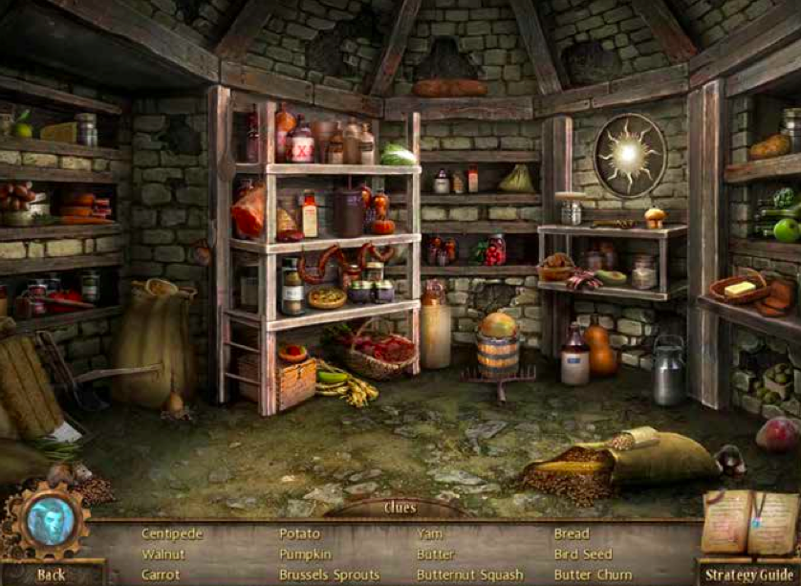
Image 1 Screenshot taken from Beauty and the Beast Mystery Legends

Slide 8

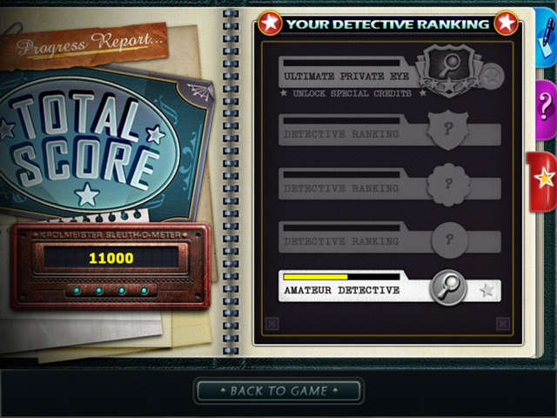
Female students & Male students
Beauty and the Beast Mystery Legends
Grim Tales the Legacy
Notes:
It is also necessary to take your students’ interests into consideration. Working primarily at a women’s college, I tend to look for games that have a fantasy or romantic element in them because these are story
Lines that consistently interest my students.
Our female students were excited to play this game and thought the story was entertaining. I am not sure how interesting game would be for a middle-aged group of men or women in other cultural settings.
For male students, I would definitely choose something different, maybe with more action and less romance.
Picturelarin altina yaz ilkine fantasy and romantic , for men more action and less romantic
You want to make sure that the game would be interesting for your group of students. One game might be great for one group, but disastrously with another.

Slide 9
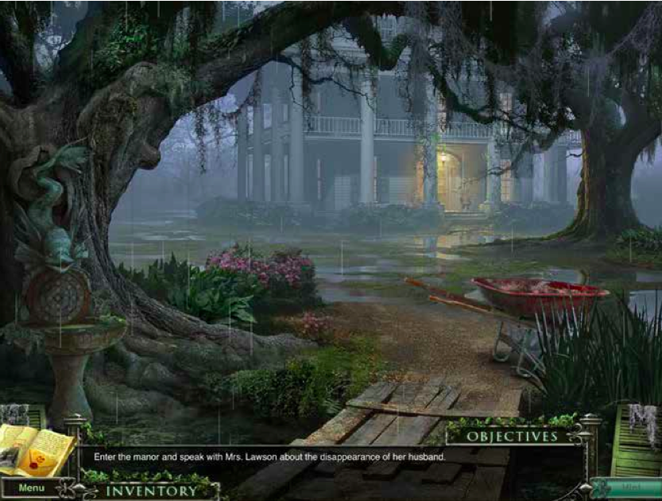
Screenshot taken from the 13th Skull
Notes:
Lowest level students will understand what they need to do. so they can guess from the context of the story what they need to do next.
Even if they don’t know what a manor is, they will see the word enter and a house in the background,

Slide 10
Research Question?
Does playing video game improve Vocabulary knowledge?
Does playing video game help to improve English?

Slide 11
Methodology
Lower-level foundation students
33 students
Pre-game Vocabulary quiz
Post-game Vocabulary quiz
Survey
Notes:
It was the first time after two years of teaching in the foundations programme that the students didn’t want to take a break. Not one of the 22 students turned away from their computers for their computers for their 10 minute break.
One group took notes while the other simply played the game. After they finished, they were given a vocabulary test. Both groups learned new words due to playing the game.

Slide 12
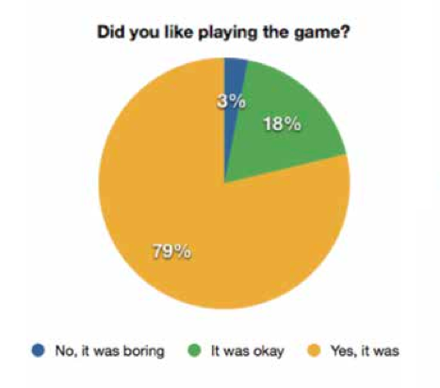
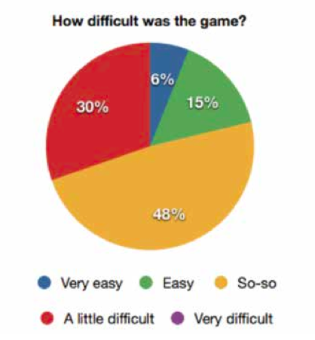
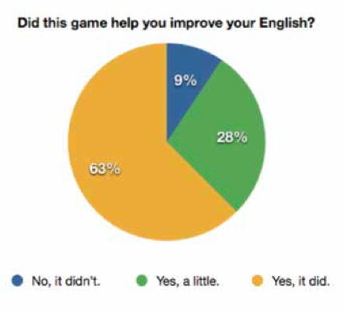
Results
Notes:
In the past year, several faculty at Ras Al Khaimah Women’s College have introduced adventure games to their students. The overall results were positive. The students are engaged and motivated to play the games.
The average score on the first quiz was 27% and increased to 61% on the second quiz. The students improved their vocabulary knowledge by %34 some the students even received a 100% on the quiz.

Slide 13
Limitations & Future research
Sample size
Gender
Culture

Slide 14
References
Barab, S. A., Gresalfi, M. S., & Ingram-Goble, A. (2010). Transformational play: using games to position person, content, and context. Educational Researcher, 39(7), 525–536.
Bronstring, M. (2012). What are adventure games? Retrieved from http://www. adventuregamers.com/articles/view/17547
Chen, H. H. and Yang, T. C. (2013). The impact of adventure video games on foreign language learning and the perceptions of learners. Interactive Learning Environments, 21(2), 129-141.
Whittaker, S. (2013). Educational Use of Video Games in the ESL Classroom. UAE Journal of Education Technology and eLEarning. Retrieved from http://ejournal.hct.ac.ae/wp-content/uploads/2013_Article01.pdf

Slide 15
Suggested Articles
http://w01.anthologizrtest.da.ulcc.ac.uk/8/1/Game-Informed_Learning-__Applying_Computer_Game_Processes_to_Higher_Education.pdf
https://net.educause.edu/ir/library/pdf/ffpiu019.pdf

Slide 16
Thank you

