Slide 1


Bekir Mugayitoglu
Keep coding

Slide 2
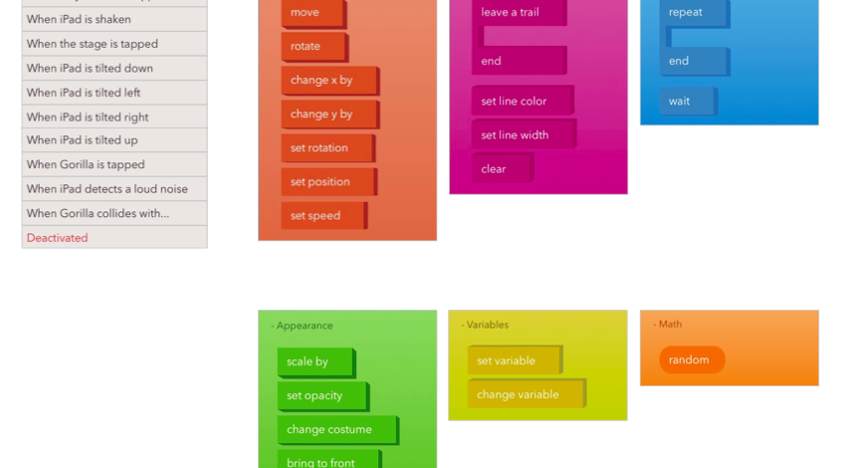
Event holders

Slide 3
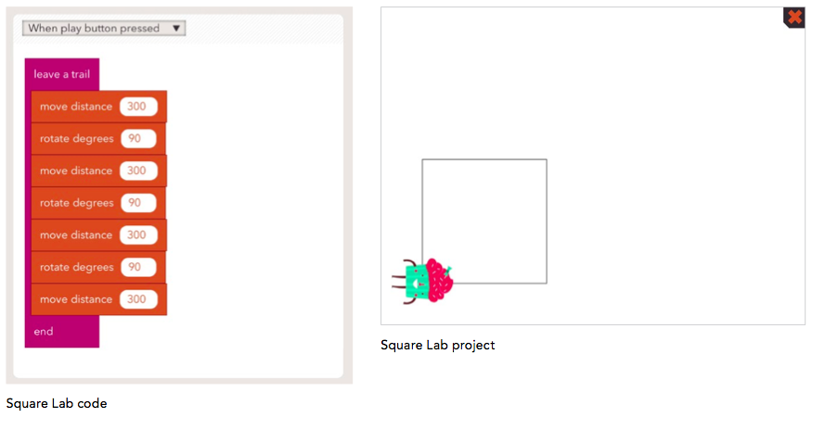
Square

Slide 4
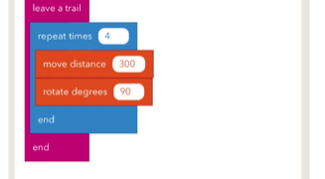
Square short cut

Slide 5
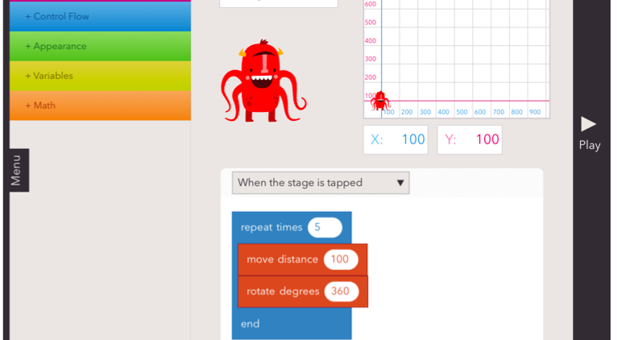
Cartwheel

Slide 6
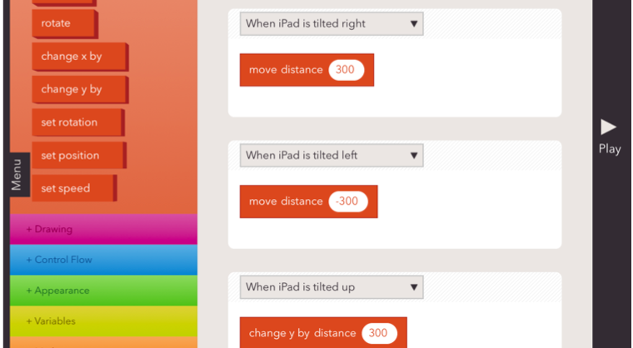
Tilted the ipad (Right, left, up & down)

Slide 7
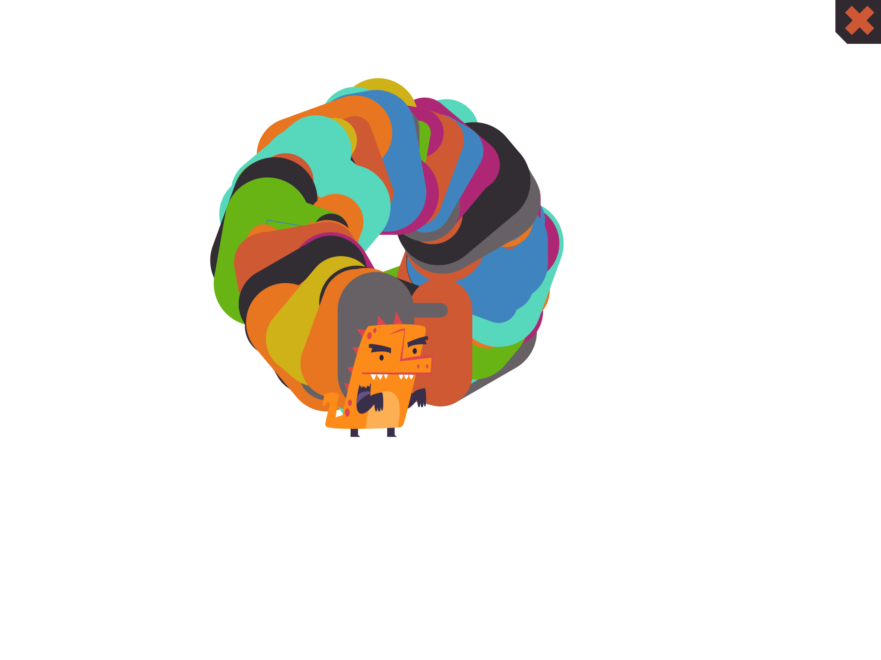
Coding is on next slide

Slide 8
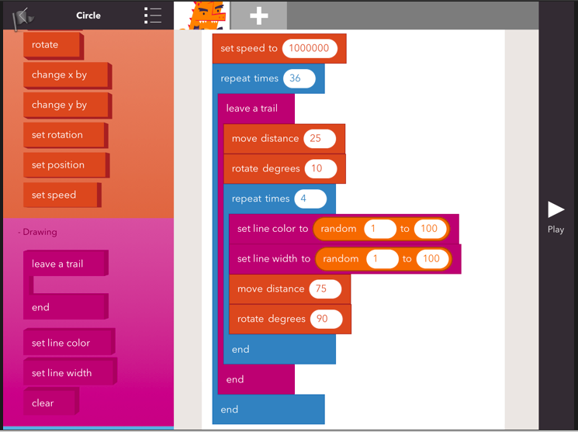

Slide 9
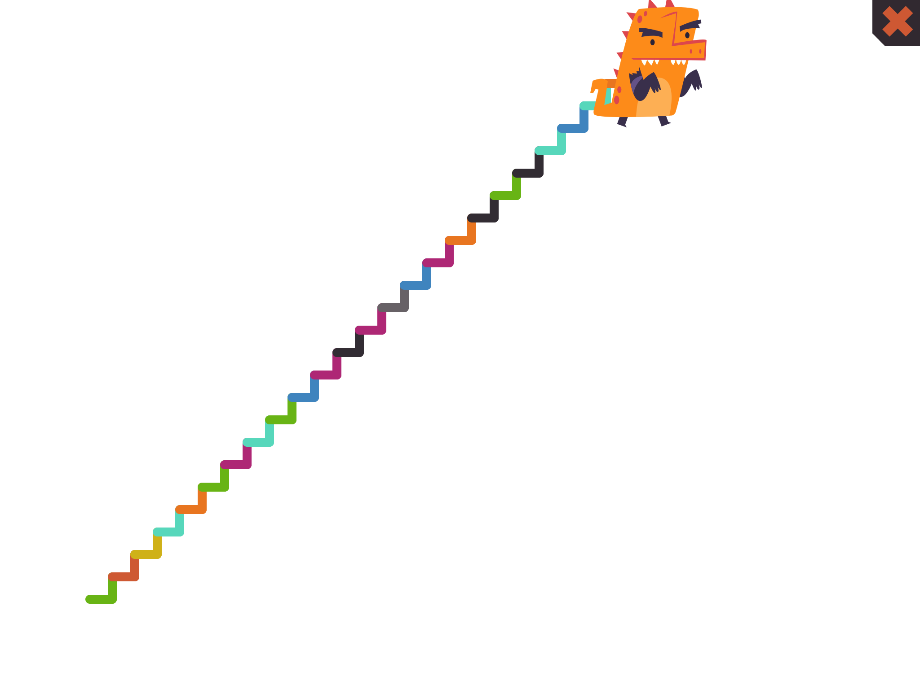
Coding is on next slide

Slide 10
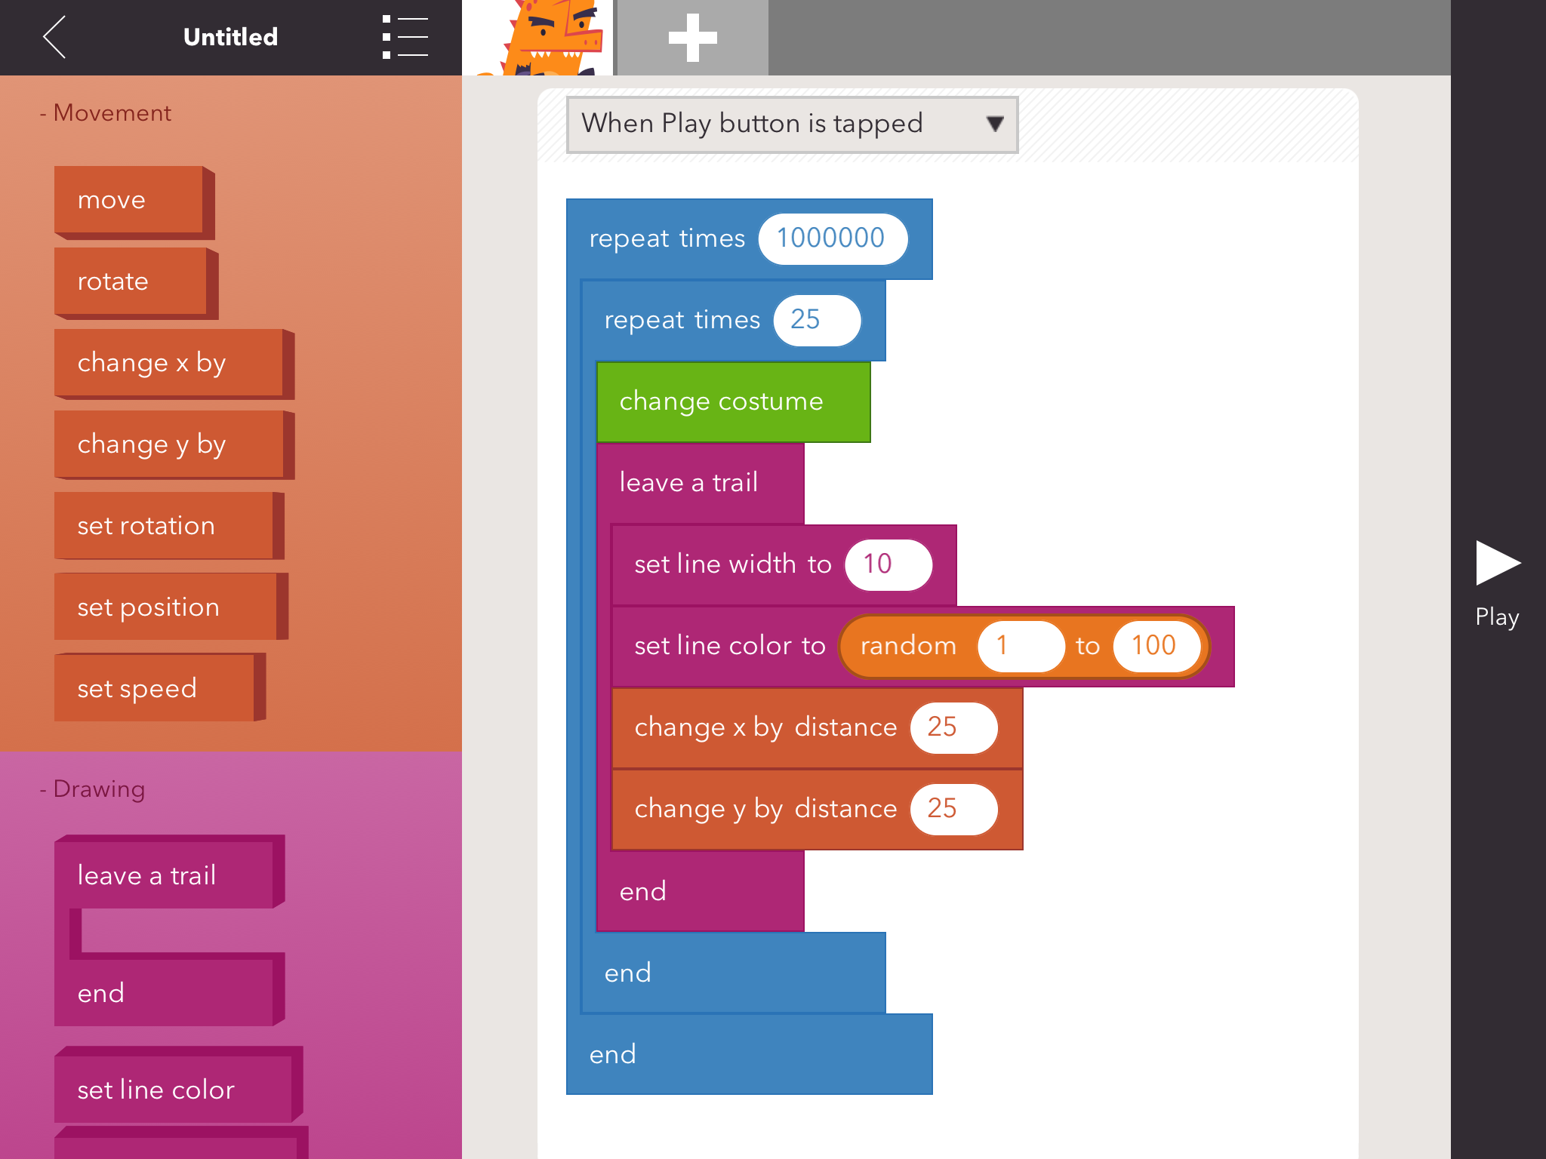

Slide 11
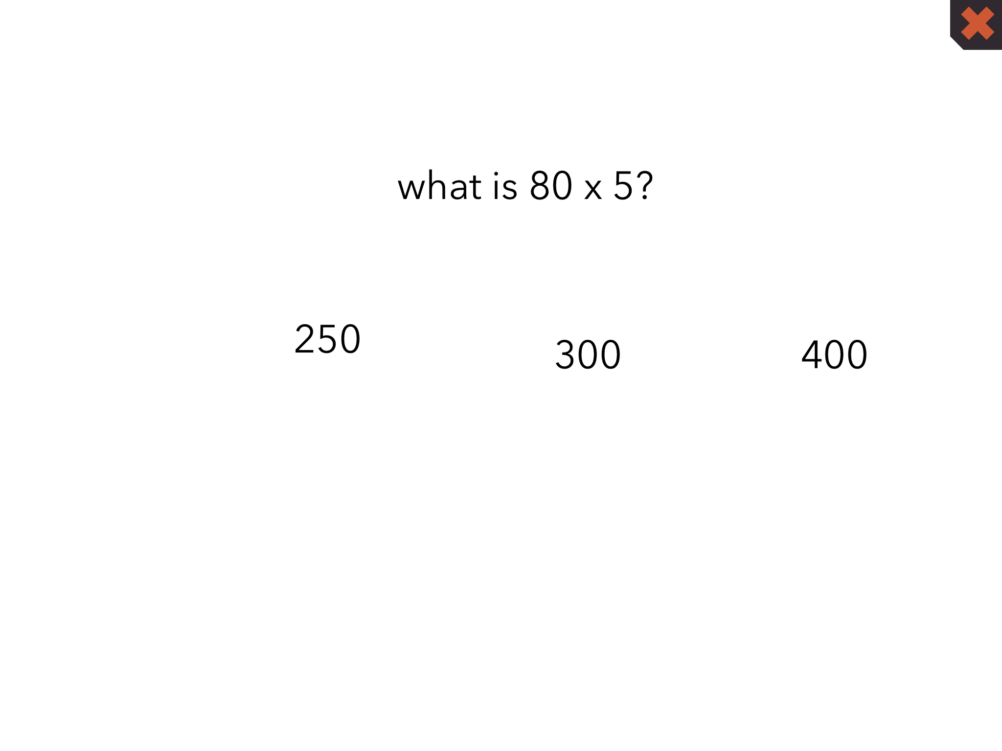
Coding on next slides

Slide 12
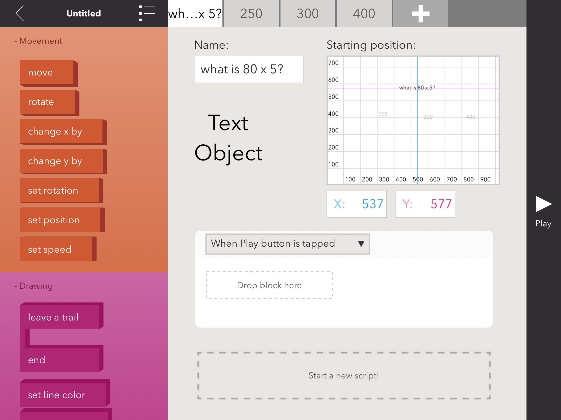

Slide 13
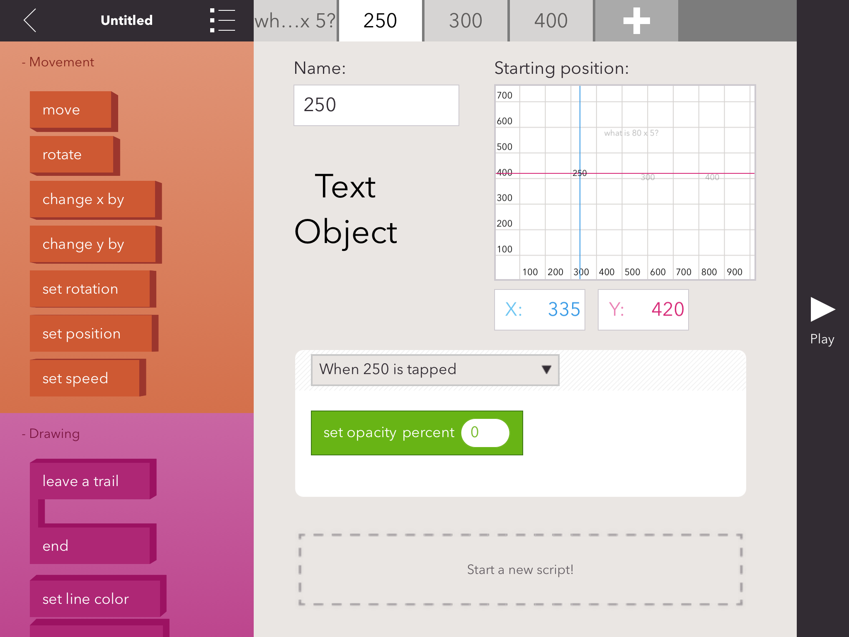

Slide 14
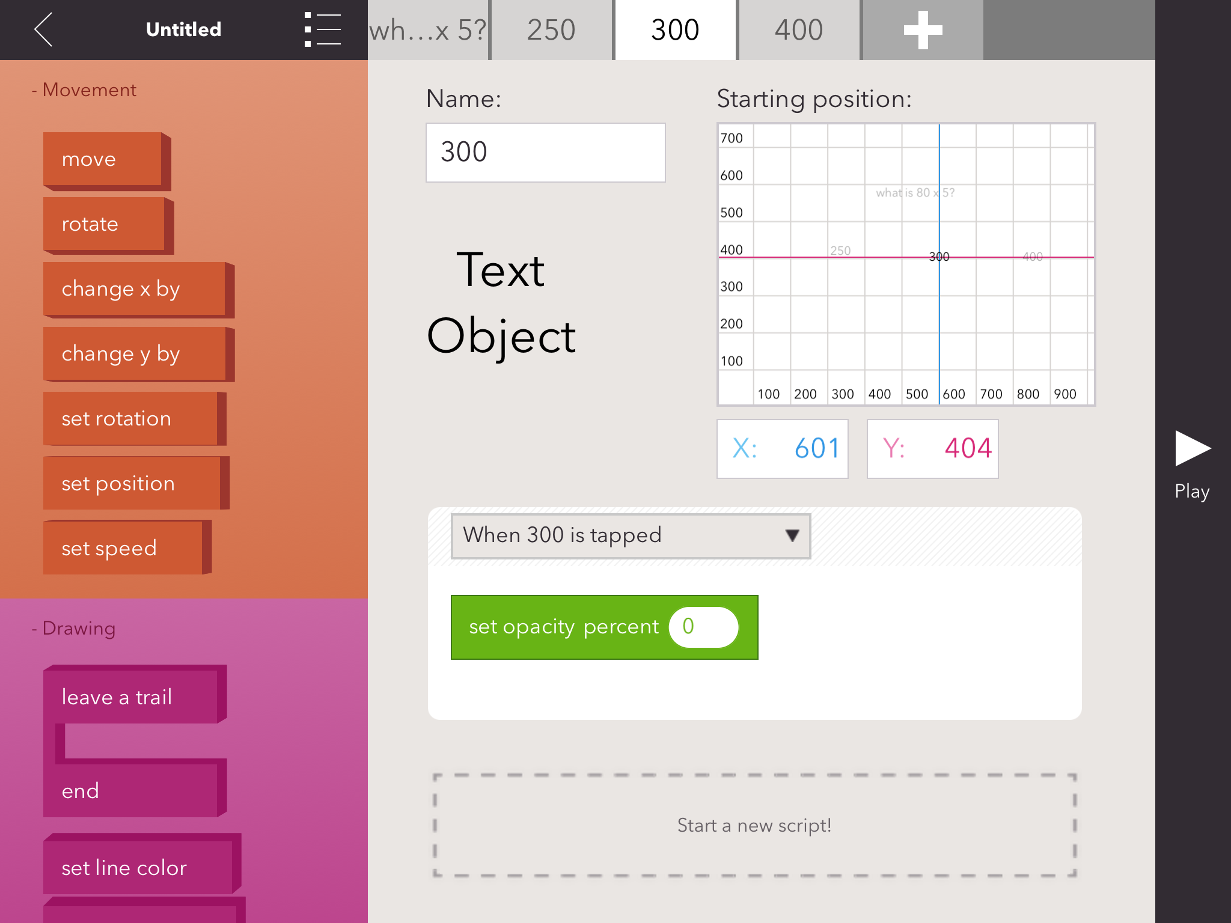

Slide 15
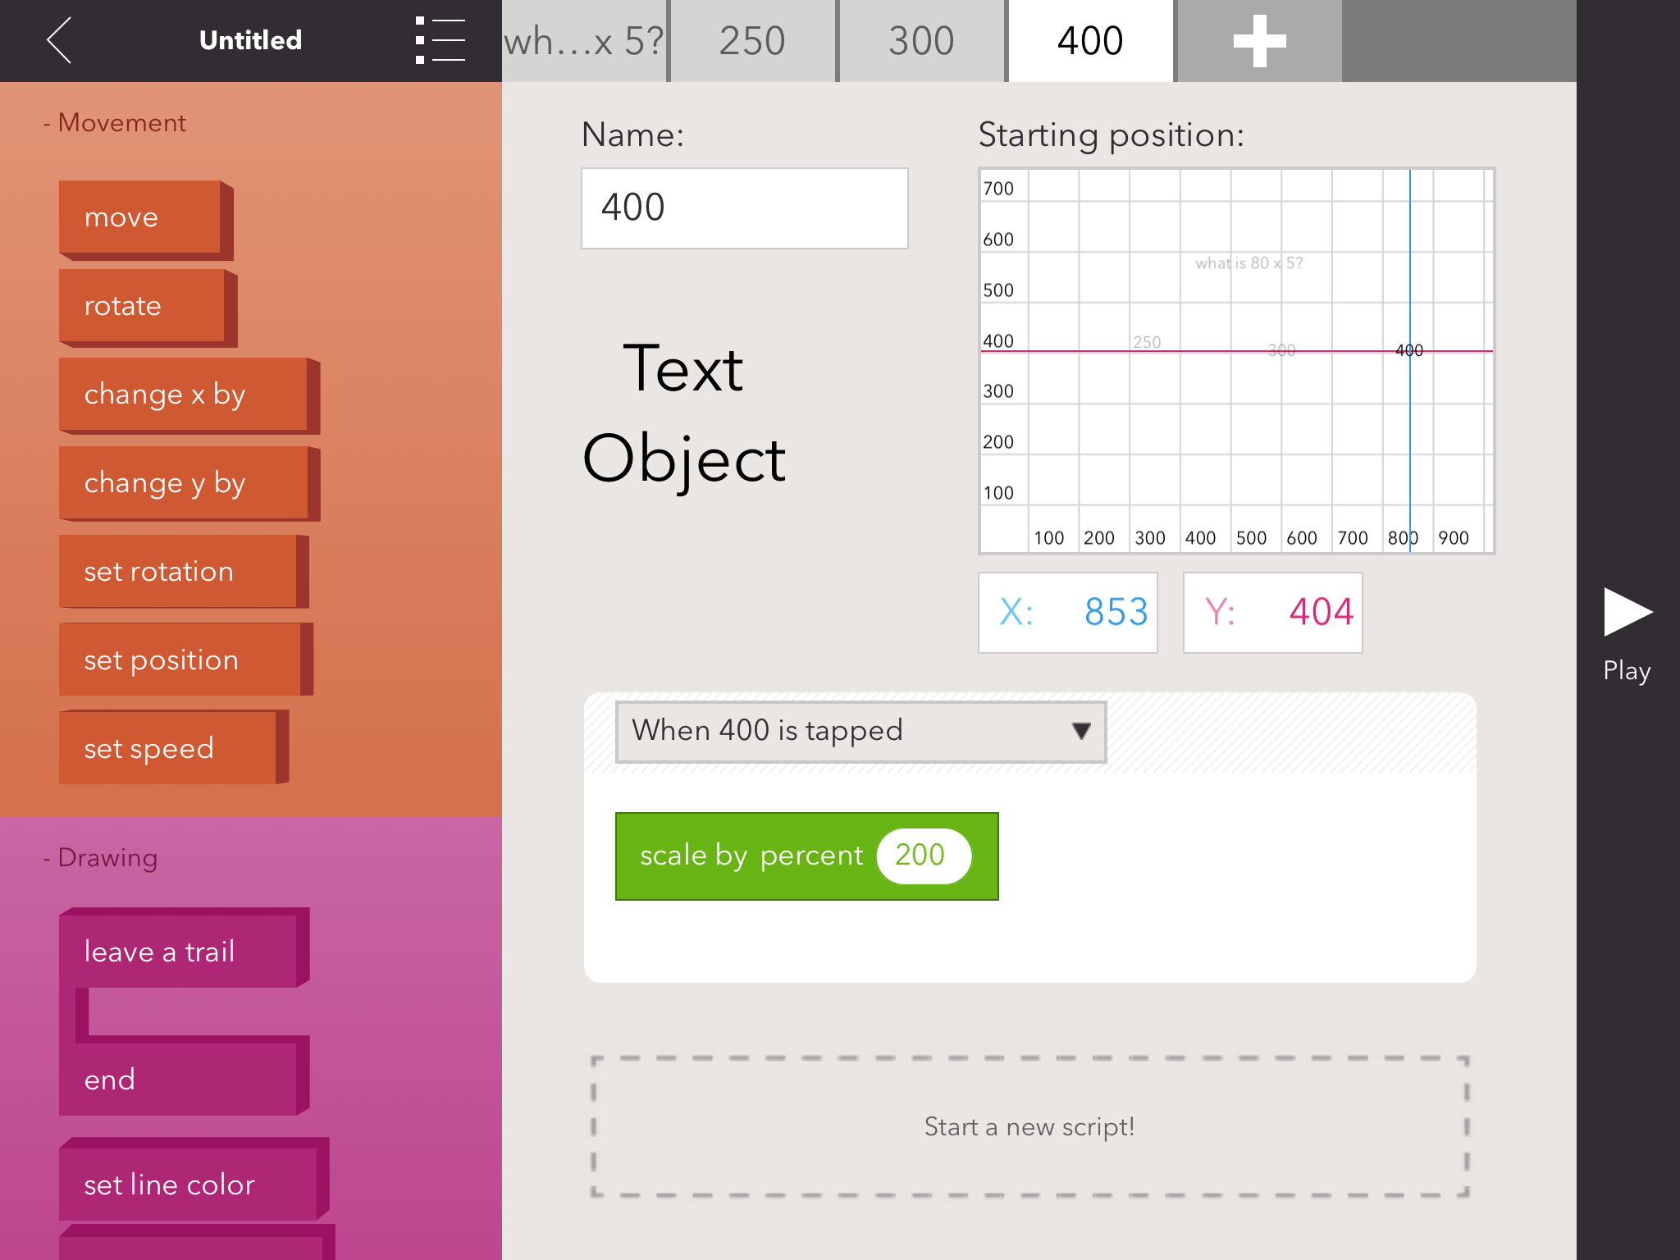

Slide 16

Coding is on next slide

Slide 17
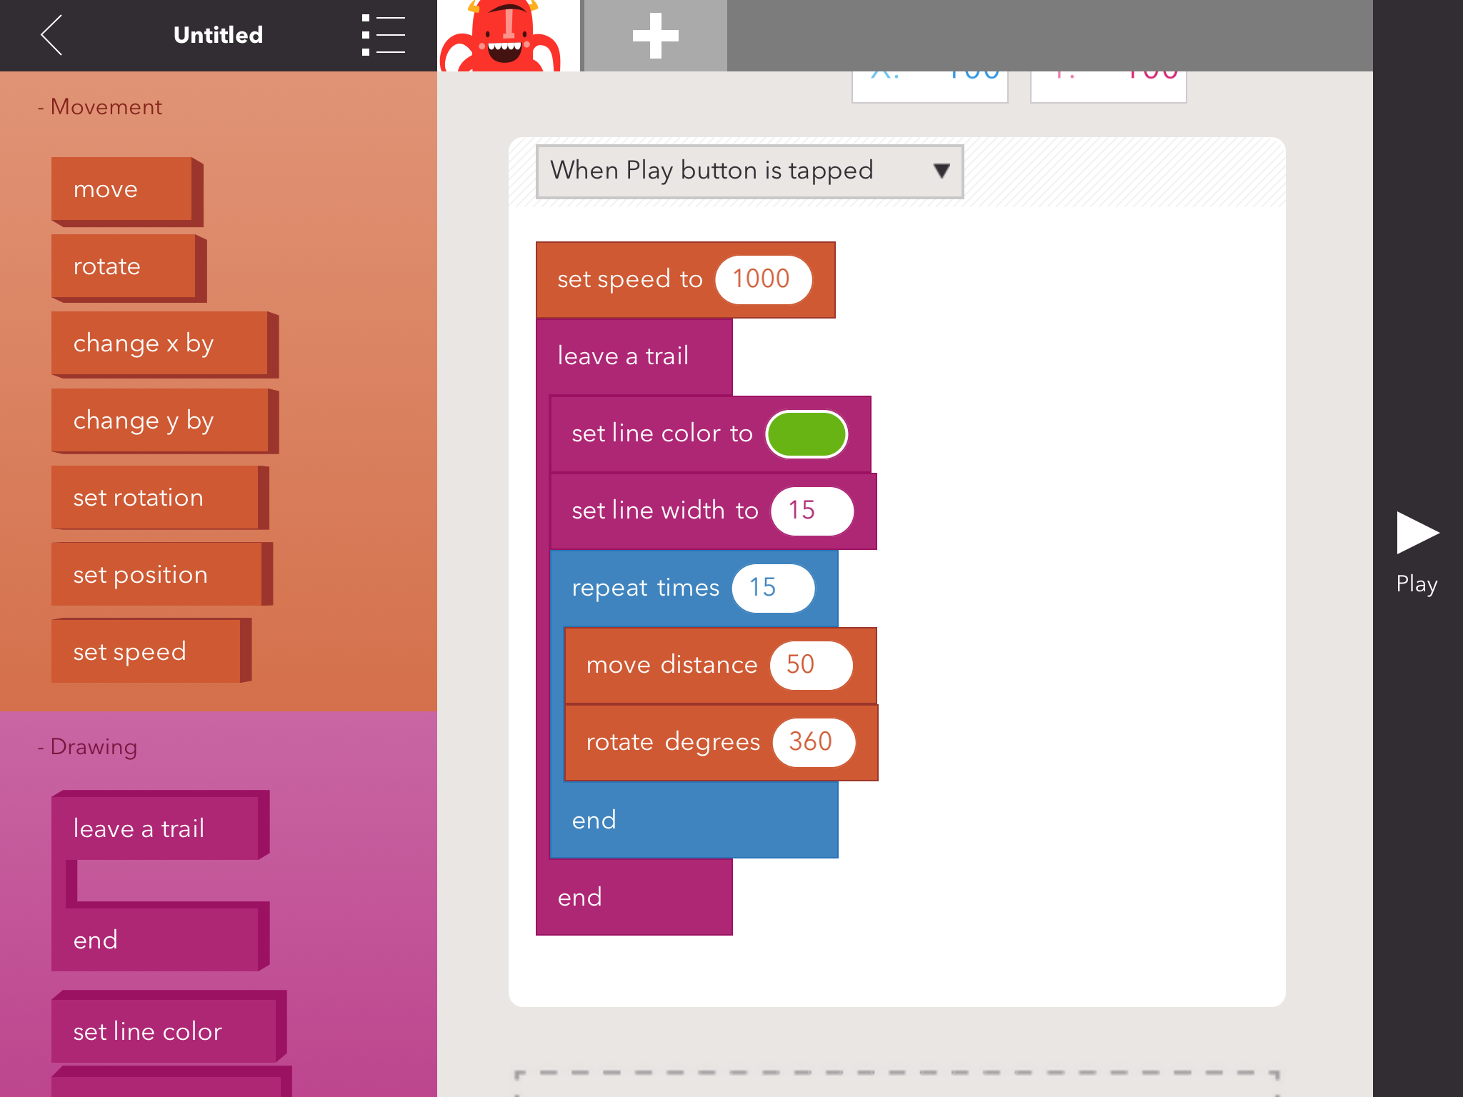

Slide 18
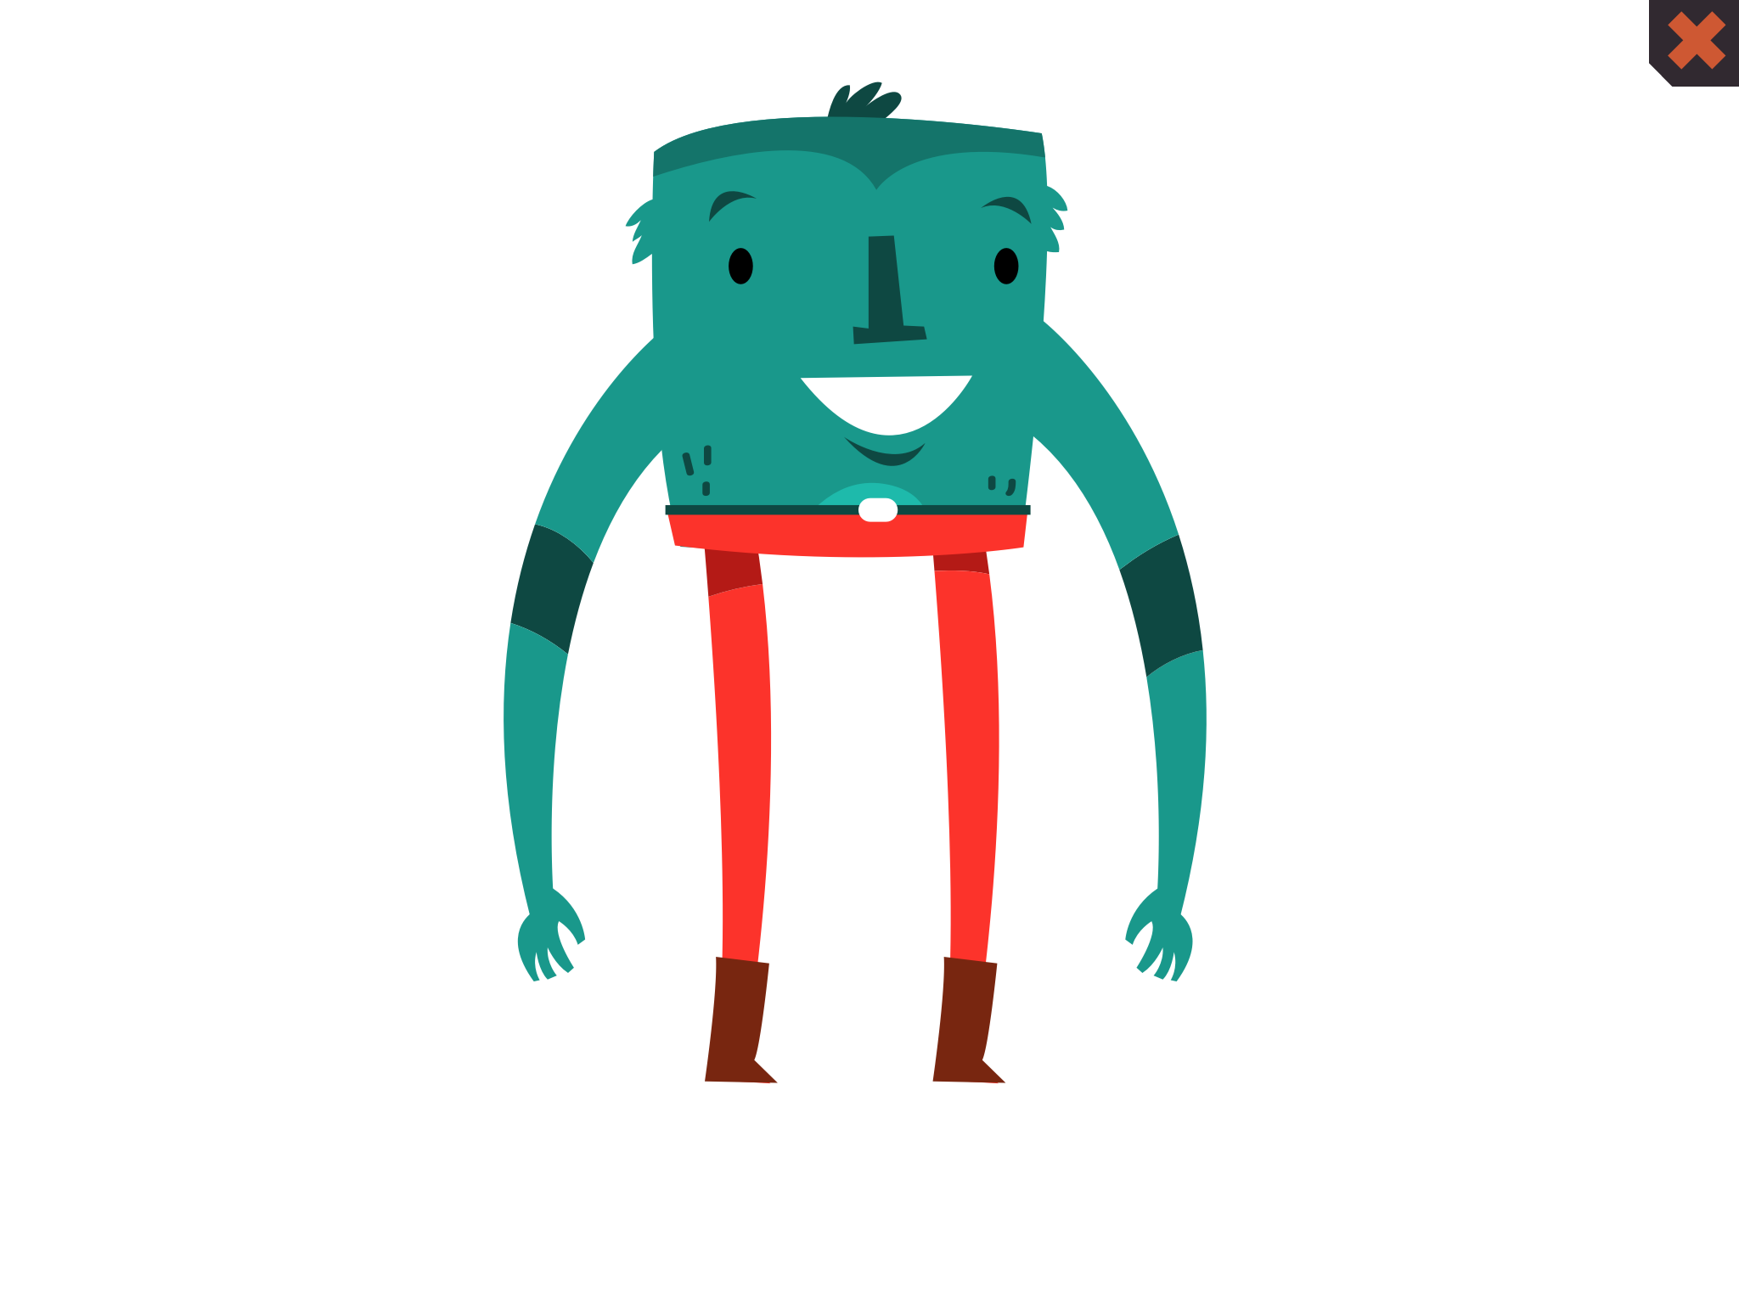
Coding is on next slide

Slide 19
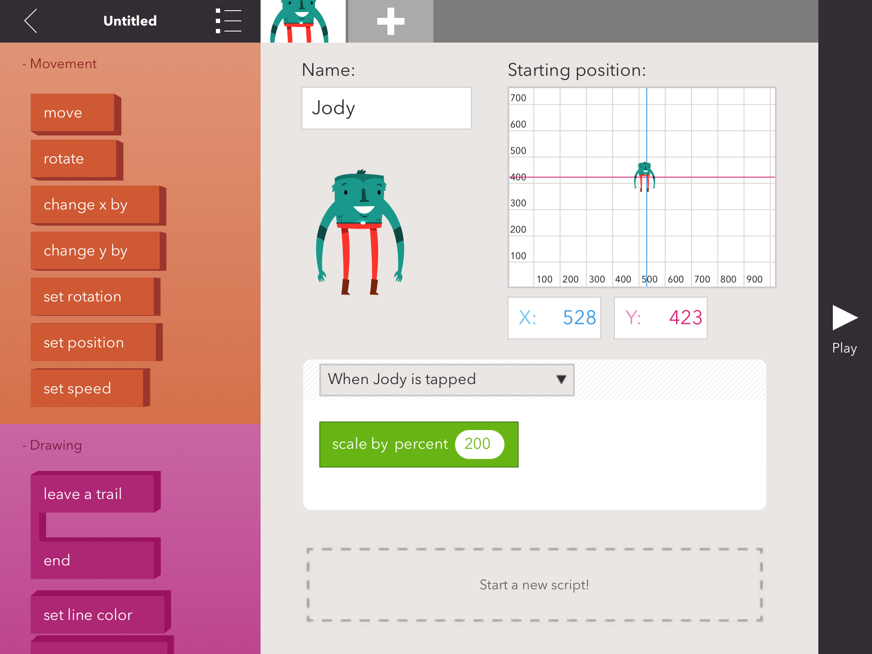

Slide 20

Coding is on next slide

Slide 21
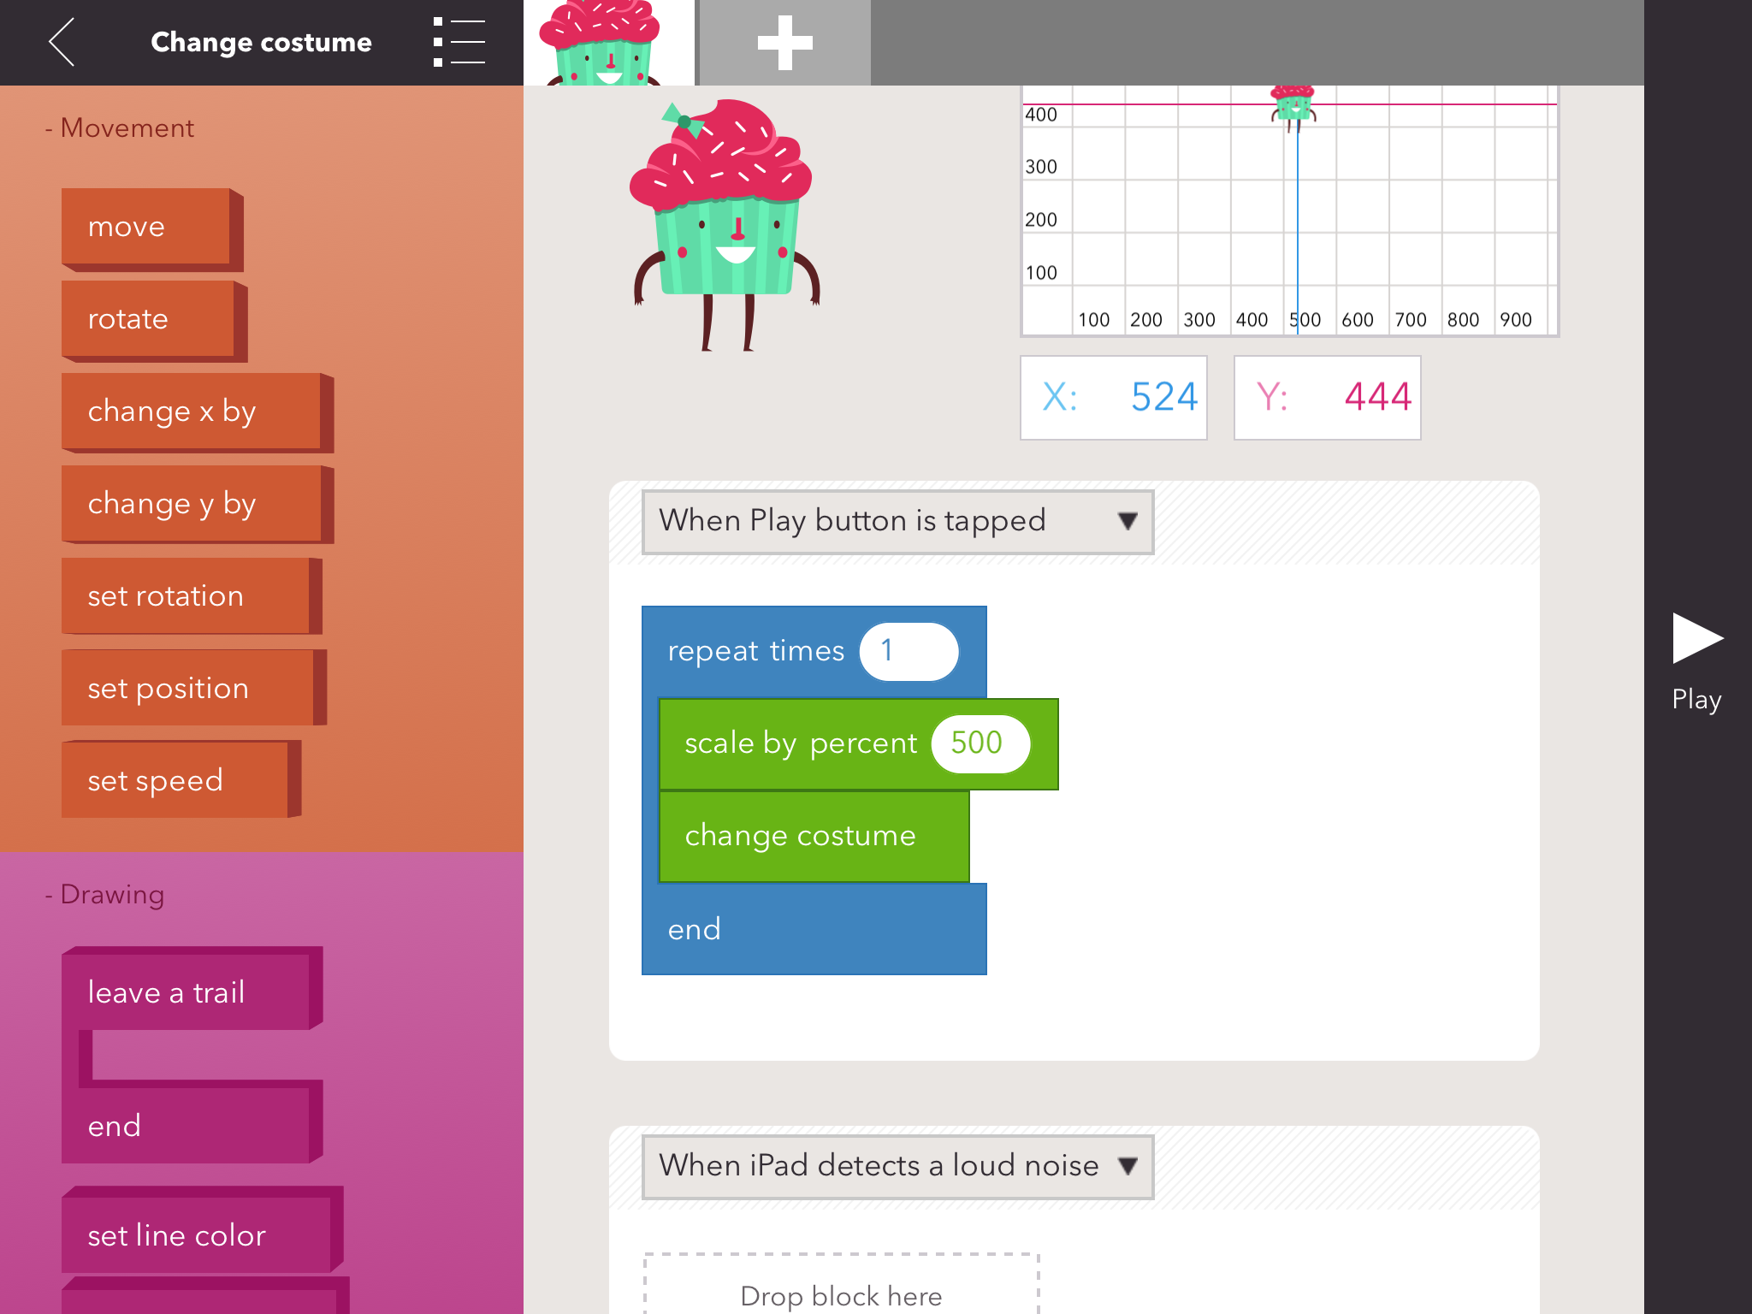

Slide 22

Coding is on next slide

Slide 23
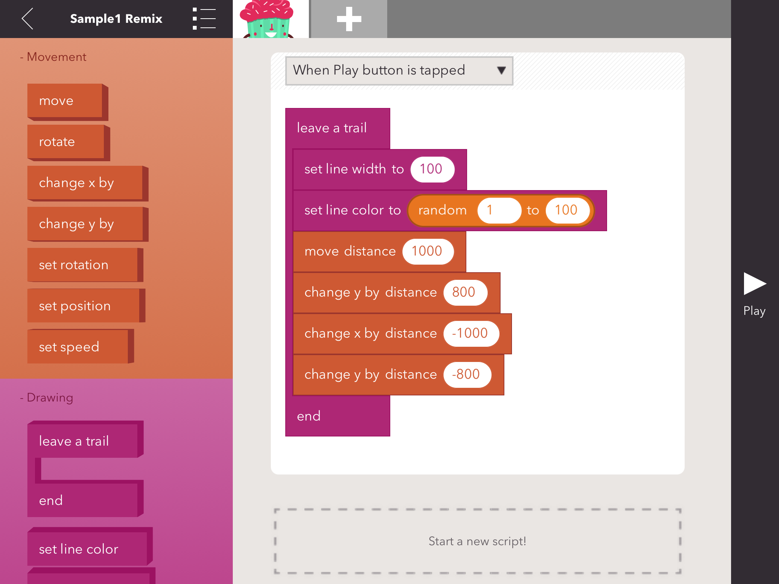

Slide 24
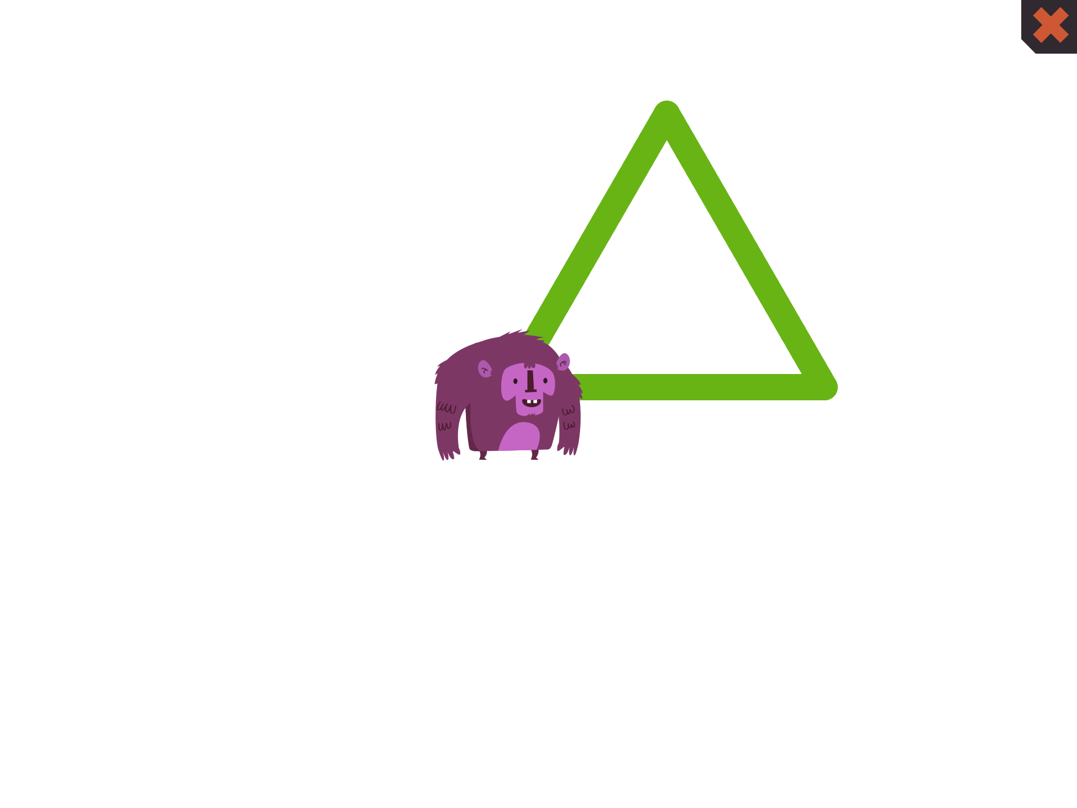
Coding is on next slide

Slide 25
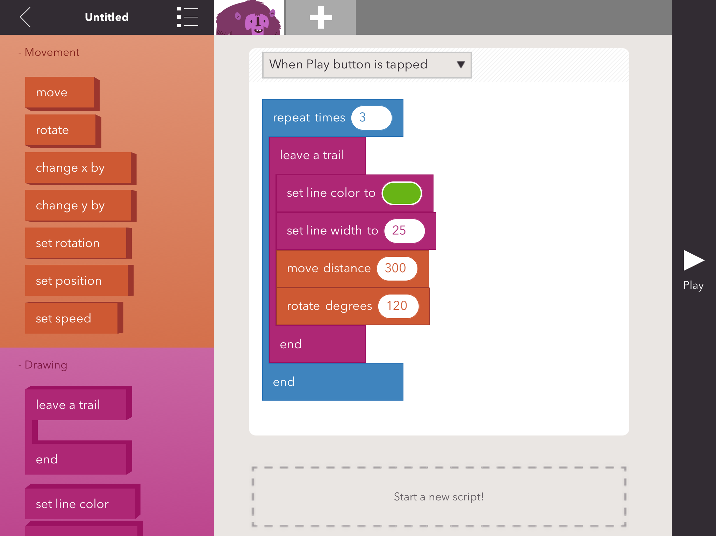

Slide 26
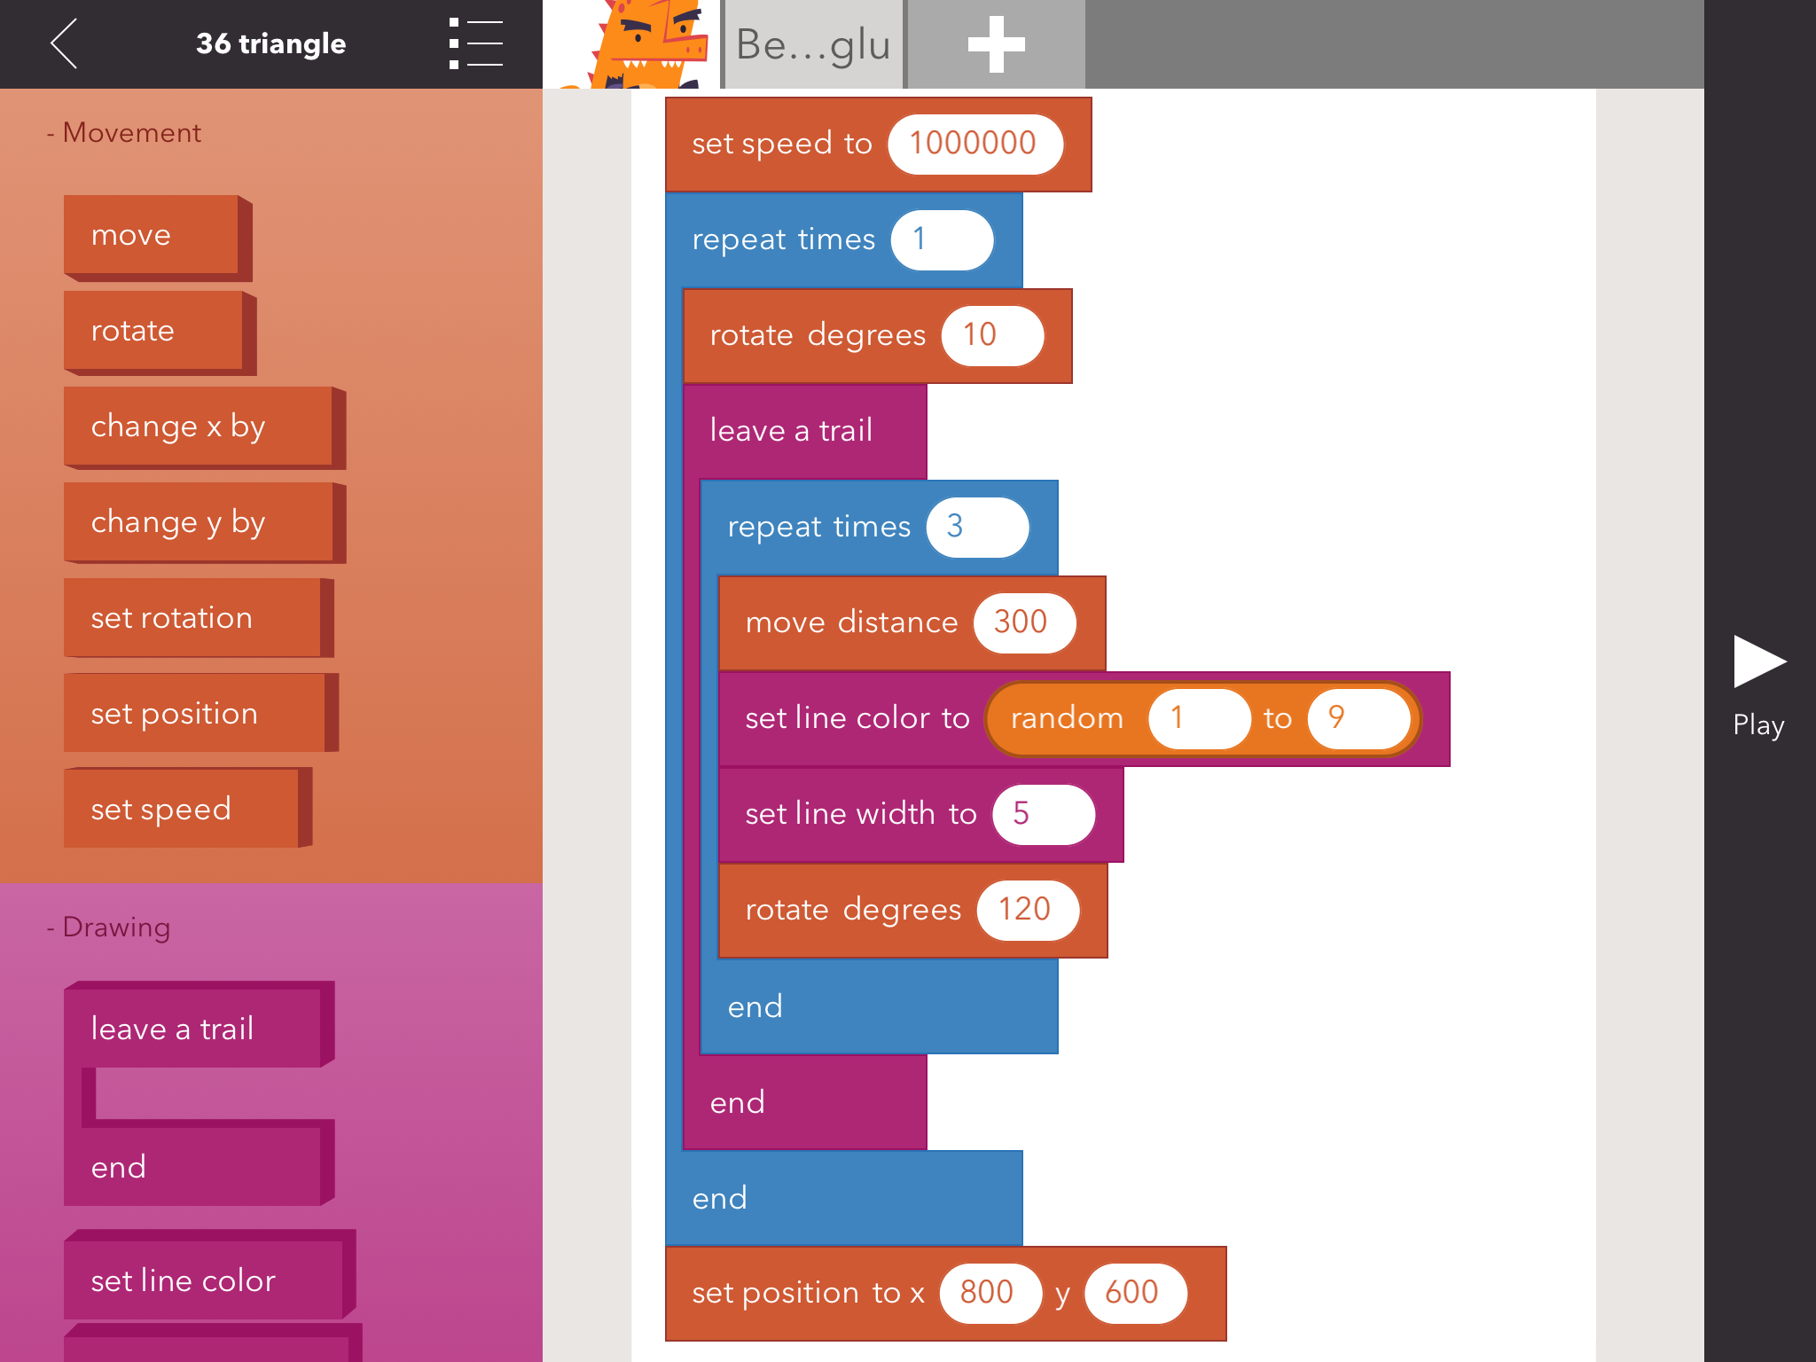

Slide 27
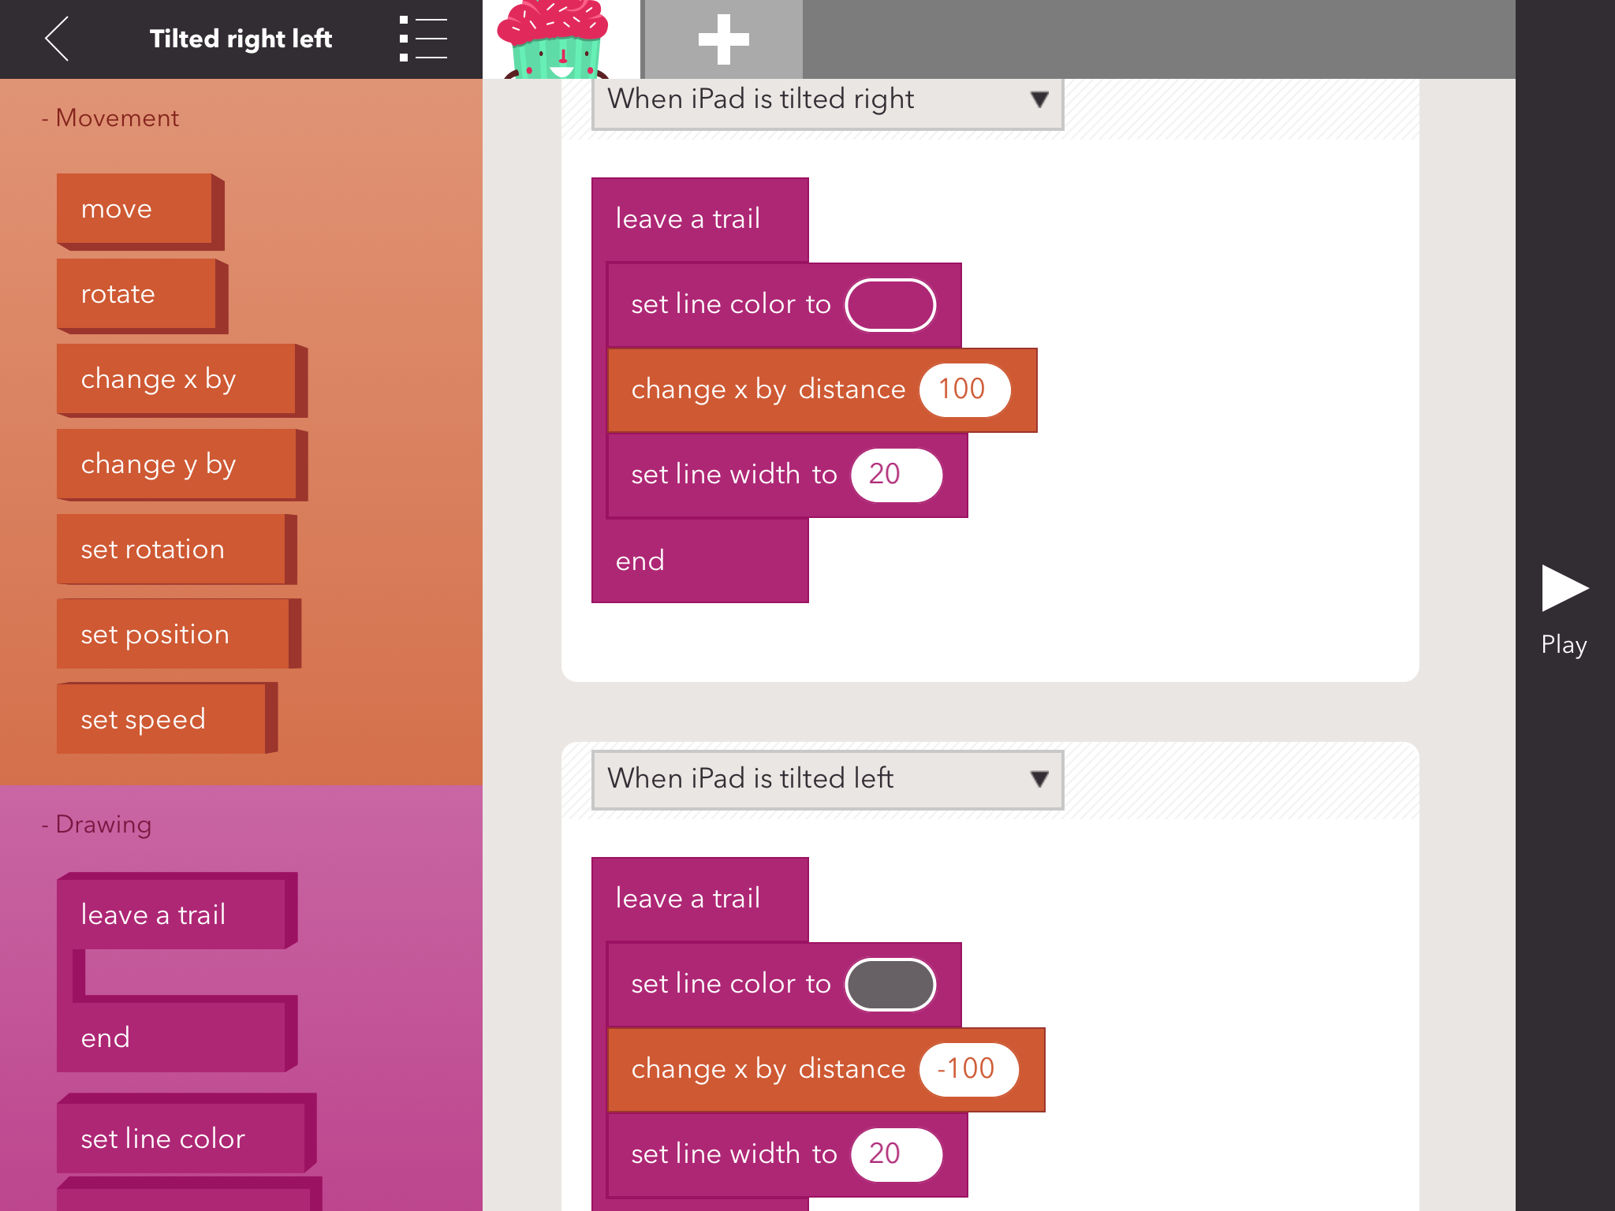

Slide 28
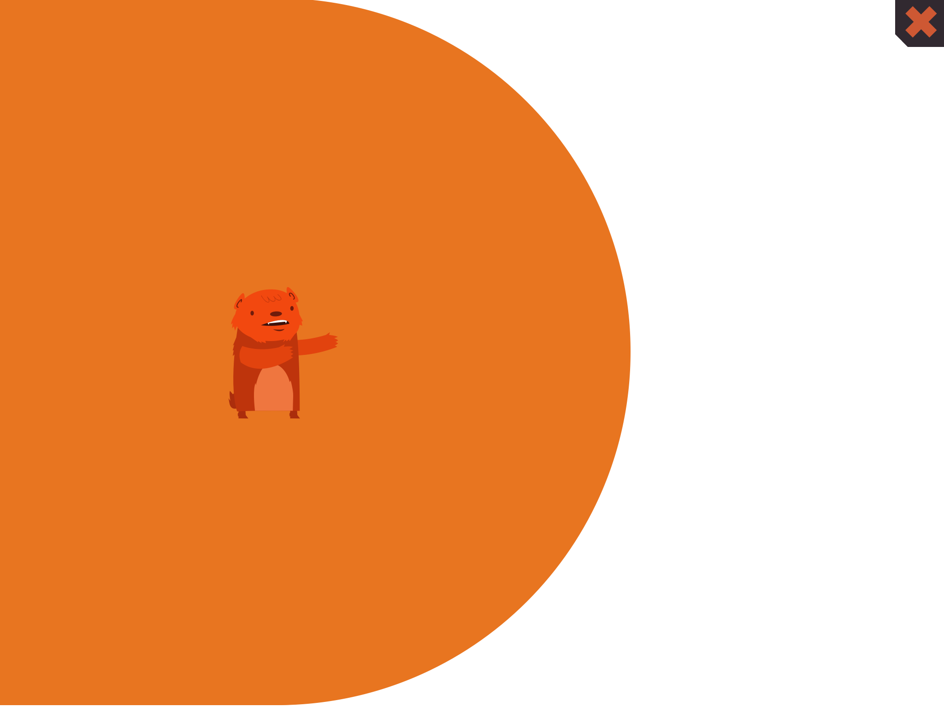
Coding is on next slide

Slide 29
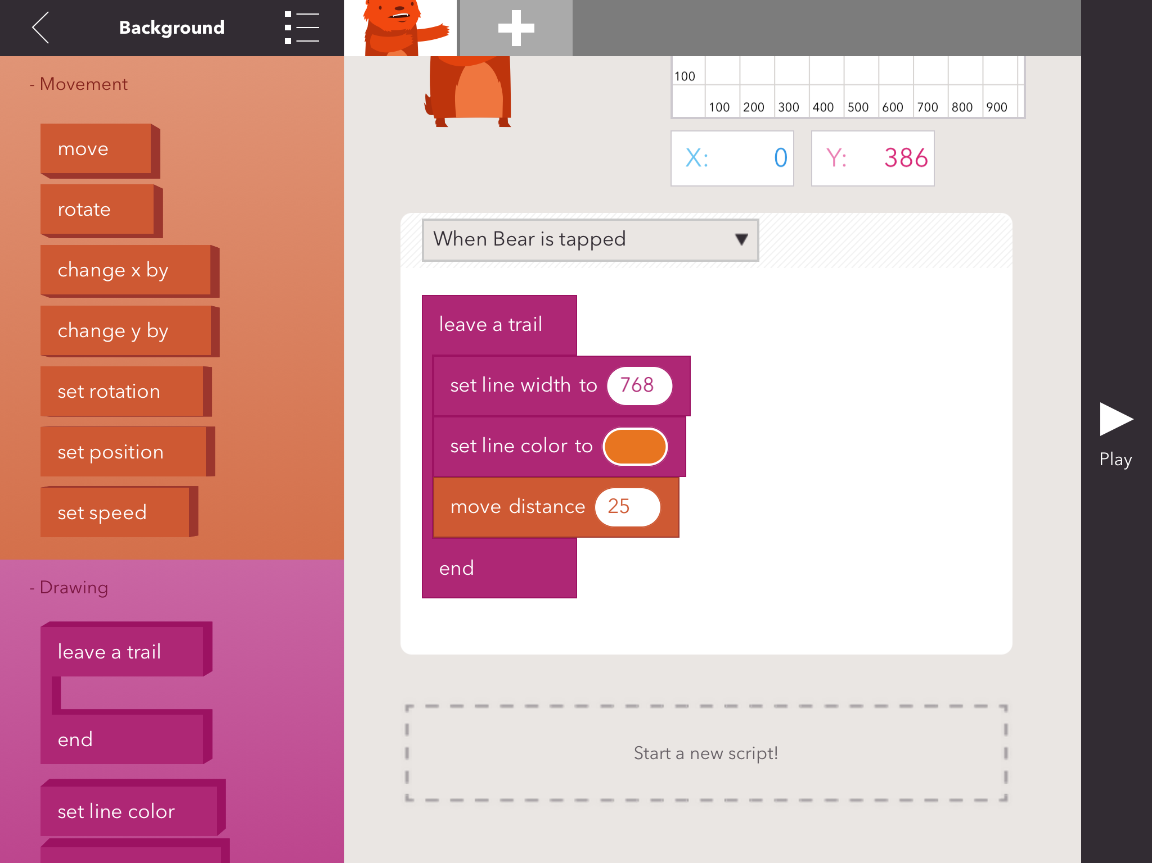

Slide 30
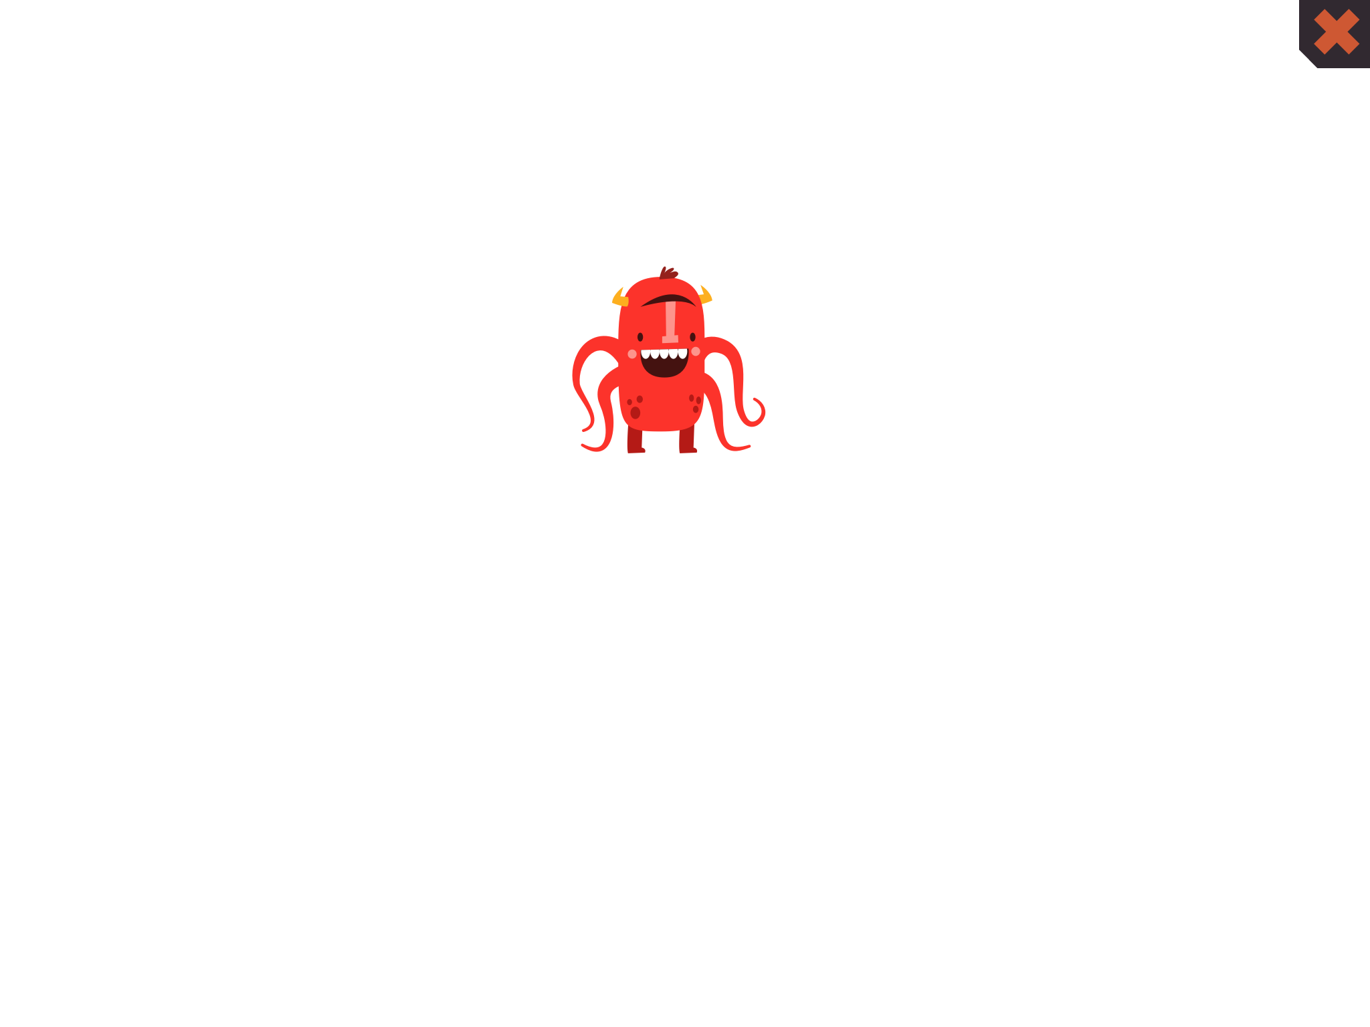
Coding is on next slide

Slide 31
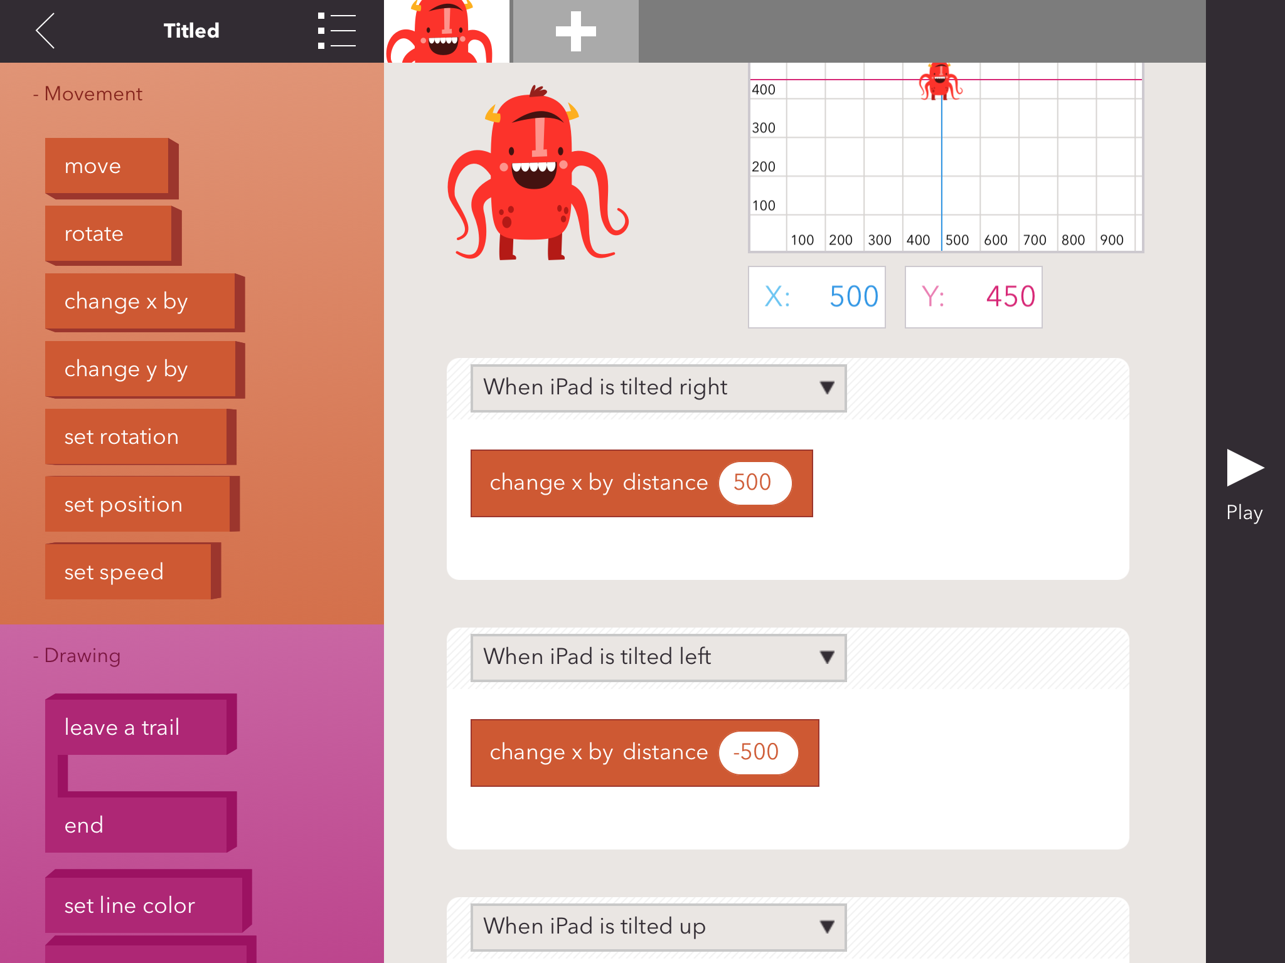

Slide 32
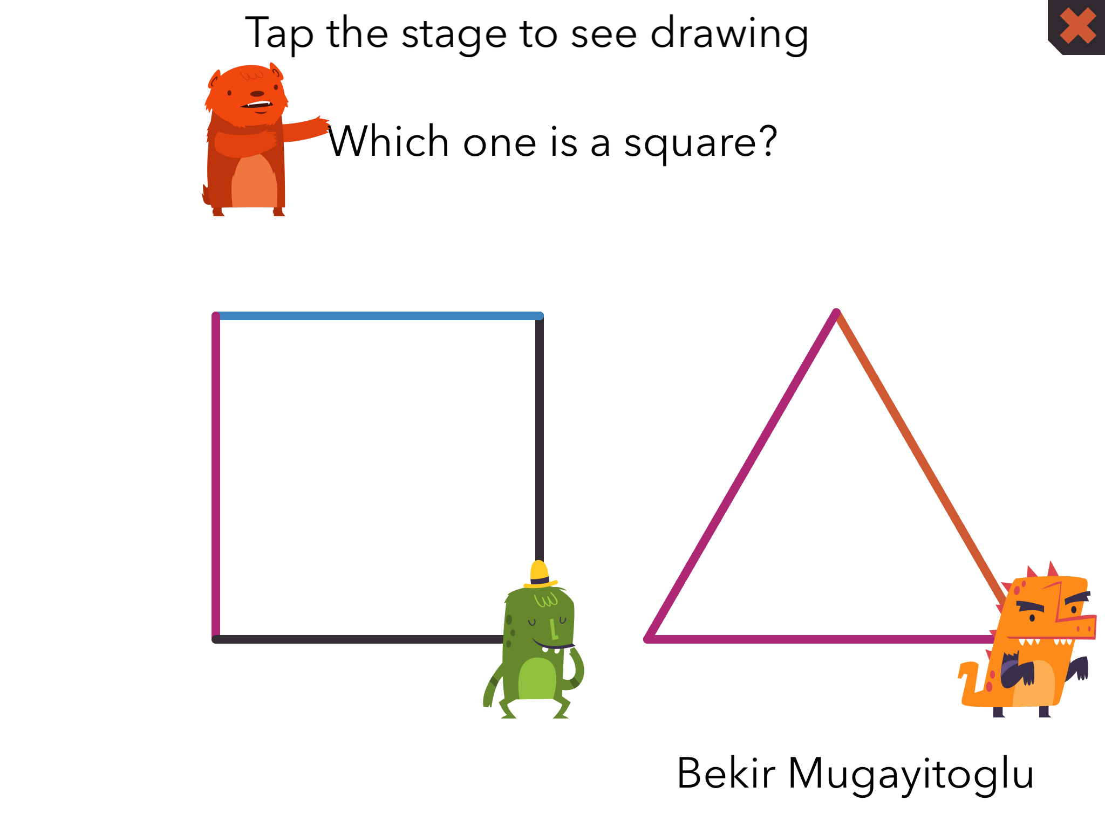
Coding is on next slides

Slide 33
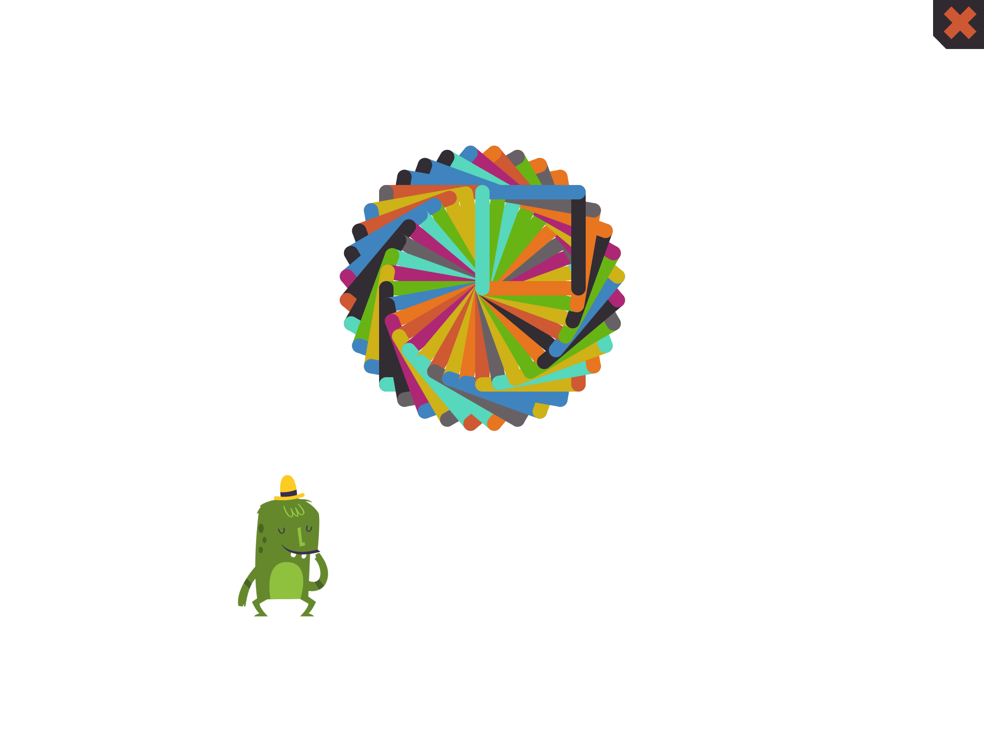
Coding on next slide

Slide 34
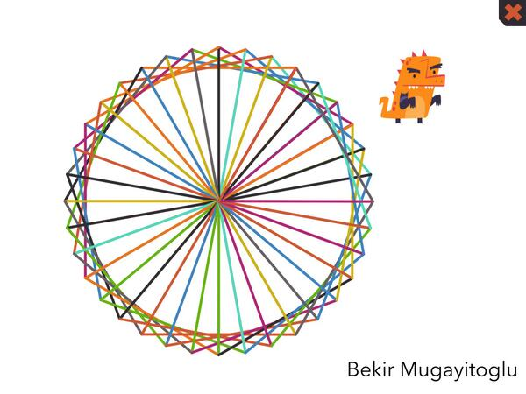

Slide 35
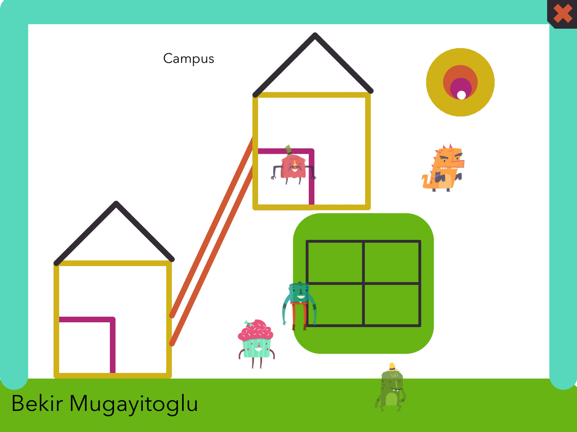

Slide 36
Assignment
Create a project using commands and experiment with and try to use all of them below
Work together as a group (3 students) project until next class class time.
Create a question project
Create a geometrical shape ( Square, pentagon, Octagon, Triangle, Circle, Hexagon, etc.)
Digital story, games ( Campus & Right, left, up, down tilted the ipad, etc. )
Experiment with and try to use all of them below:
Move
Set line color
Set line width
Rotate
scale by percent
change x by distance
change y by distance
set opacity
change costume
Leave a trail
Repeat end
Wait
If you have any questions, don’t hesitate to email me,
Bekir Mugayitoglu
mugayit635@duq.edu

