Slide 1

Instructional Gaming: Exploring Social and Cognitive Benefits for ESL Learners
Jessica L Barron
Bekir Mugayitoglu
Duquesne University

Slide 2

Session Overview
Instructional Gaming: Learning with play
Diversity in Instructional Gaming
Educational Use of Video Games in the ESL Classroom

Slide 3
Instructional Gaming
Learning with play

Slide 4

What is Instructional Gaming?
Instructional gaming is using gaming software to motivate and teach students with a hands-on and interactive experience
Instructional Gaming can be competitive and is guided by rules
Instructional Gaming can create immersive learning experiences

Slide 5
Why Instructional Gaming?
Attention
Retention
Production
Motivation
In support of Outcome-Based learning initiatives, instructors and administrators are using a variety of creative learning environments to teach learners of all ages
Simply observing a model in action is not enough for a learner to retain all that they have learned. In order to truly retain their knowledge, they should demonstrate their skills through the following steps:
Evidence suggests that textbooks and rote learning are simply ineffective for many students today.
Timothy Shorthouse Baoying Wang

Slide 6

Why Instructional Gaming?
Instructional gaming creates a technology rich learning environment for learners of all ages
  iPads and tablets in elementary school
  Console games can be found in junior/high school
  Complex PC simulations are used in Universities and military
By helping students connect virtual accomplishments to real-life scenarios, we lead learners closer to John Dewey's ideal of learning.
  Sasha Barab

Slide 7
Diversity in Instructional Gaming
The methods of learning with Video Games

Slide 8

Hand Held Devices
Variety of Formats
  iPad and other tablets
  Nintendo DS, PS Vita
Portable and versatile
Simple to use
Offer multi-player solutions
People laughed at us for using the word magical. But you know what? It turned out to be magical.
Steve Jobs

Slide 9
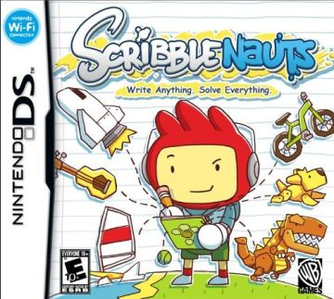

Faces iMake – ABC, iPad
Scribblenauts, Nintendo DS

Slide 10

Console Video Games
Consoles include Playstation, Xbox, Nintendo Wii
Robust games with a variety of gaming options
Consoles offer games that encourage kinesthetics
Hardware and games can be expensive, and are not portable
New stimuli compel kids to learn using new methods, work in unfamiliar contexts, or challenge and upend long-held preconceptions.
Nina Holmberg, Discovery.com

Slide 11

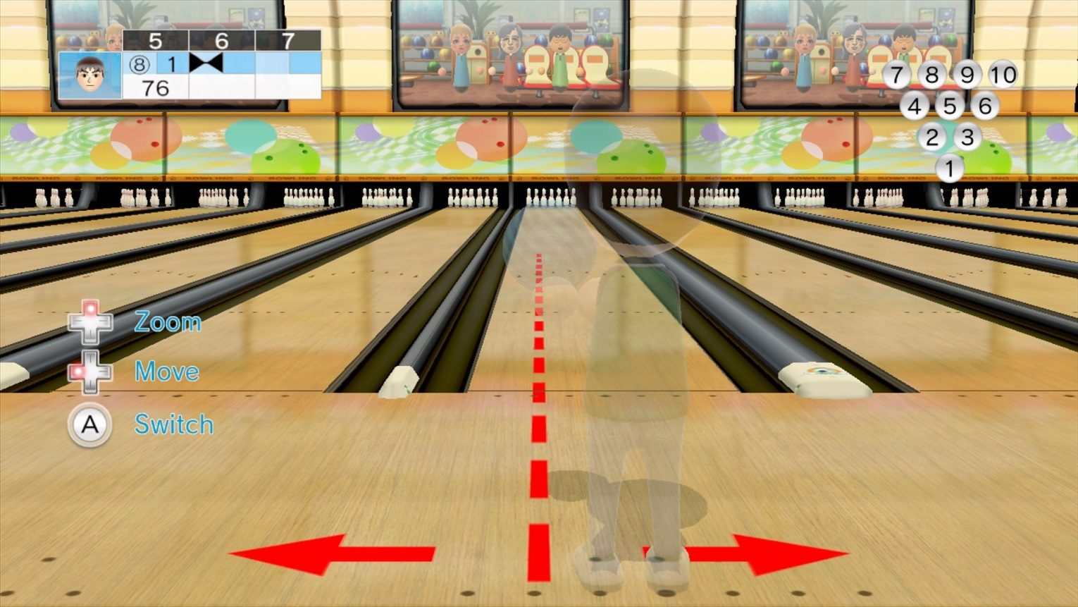
Wii Sports, Nintendo Wii
Portal 2, Playstation 3

Slide 12

PC Video Games
Can be played on any Personal Computer
Easy to manage and deploy on a local network
Allows for flexibility and multi-player experience
Many mainstream games (specifically for entertainment) release educational versions at a discount to schools and instructors
Created by teachers for classroom use and officially supported by Mojang, the company behind Minecraft, MinecraftEdu contains a set of powerful yet simple tools to fine-tune the Minecraft experience for learning.
~Minecraft.edu

Slide 13
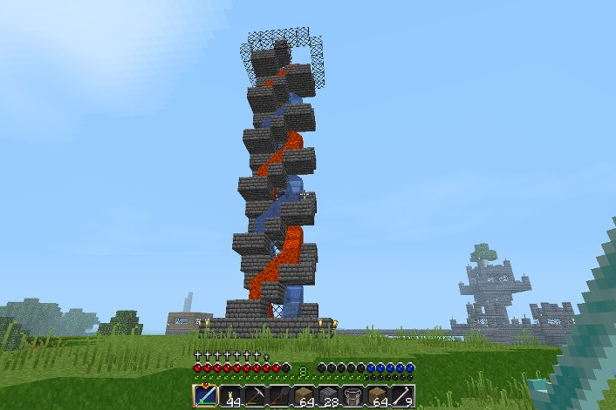

SimCity Pollution Challenge
MineCraft.edu

Slide 14
References
Barab, S. A., Gresalfi, M., Arici, A., Pettyjohn, P., & Ingram-Goble, A. (2010). Transformative play: games as 21st century curriculum. Proceedings of the 9th International Conference of the Learning Sciences, 2, 93-100.
Dempsey, J. V. (1994). Instructional Gaming: Implications for Instructional Technology. Annual Meeting of the Association for Educational Communications and Technology, Nashville, TN, 1-21.

Slide 15
Educational Use of Video Games in the ESL Classroom
Whitetaker, S. (2013)

Slide 16



Challenge of students engaged in the classroom
Notes:
Teachers have always had the challenge of keeping their students engaged in the classroom; however, since mobile technology has been introduced and become part of our everyday lives,
The challenge of keeping students focused on the learning task has dramatically increased.
Facebook, Twitter, facebook have now been added to the many distractions a 21st century student faces.
Instead of reading, there was no engagement
There is no engagement, motivation or desire to read the text in front of them and they typically just wanted to watch movie version.

Slide 17
What is adventure games?
MAREK bronstring (2012)
“ …thoughtful, engaging, and intelligent and provide some mental challenge…”
“Focus on puzzle solving within a narrative framework, generally with few or no action elements.”
Notes:
MAREK bronstring (2012) states that adventure games can be “thoughtful, engaging and intelligent and provide some mental challenge” He also “focus on puzzle solving within a narrative framework, generally with few or no action elements.”

Slide 18
How to identify the effective game in the classroom
Find existing game
The language level
Pronunciation
Well-designed game
Hint button
Vocabulary list
Play the game yourself
Notes:
Teachers need to keep in mind several factors when identifying and effective game for their students:
Teachers typically don’t have time, the skills or the resources to develop a highly engaging, visually appealing game. Therefore necessary for them to use the games that already exist.
The language cannot be too high or too low
If the language is too low, then there is nothing new for the students to learn and they may find it boring. If it is too high, then the student could become frustrated with the game and want to stop.
Teacher needs to find the right balance between gibing them a task they can achieve and challenging them so they develop their language skills.
The pronunciation should be clear. Subtitles are an additional asset.
It should be a well-designed game so that it is a challenge, but not so challenging that the player stops playing.
You do want to ensure that the language is not archaic or too colloquial.
The player needs to find things like a gnome and a machete. These words would not be in my list of top 1000 words to teach. The students can simply use the hint button to help them through this stage of the game.
Play the game several times yourself. Be familiar. This is not only includes the vocabulary, but the grammatical structures and the colloquial phrases used.

Slide 19
What teachers should do?
Pre-game activities
Prediction essays
Post-game activities
Students become teacher
Creating a walkthrough
Creating a trailer about the game
Rewriting the story
Vocabulary activities
Choosing the correct sentence
Recognizing grammar structures
Notes:
Teachers need to keep in mind several factors when identifying and effective game for their students:
Teachers typically don’t have time, the skills or the resources to develop a highly engaging, visually appealing game. Therefore necessary for them to use the games that already exist.
The language cannot be too high or too low
If the language is too low, then there is nothing new for the students to learn and they may find it boring. If it is too high, then the student could become frustrated with the game and want to stop.
Teacher needs to find the right balance between gibing them a task they can achieve and challenging them so they develop their language skills.
The pronunciation should be clear. Subtitles are an additional asset.
It should be a well-designed game so that it is a challenge, but not so challenging that the player stops playing.
You do want to ensure that the language is not archaic or too colloquial.
The player needs to find things like a gnome and a machete. These words would not be in my list of top 1000 words to teach. The students can simply use the hint button to help them through this stage of the game.
Play the game several times yourself. Be familiar. This is not only includes the vocabulary, but the grammatical structures and the colloquial phrases used.

Slide 20
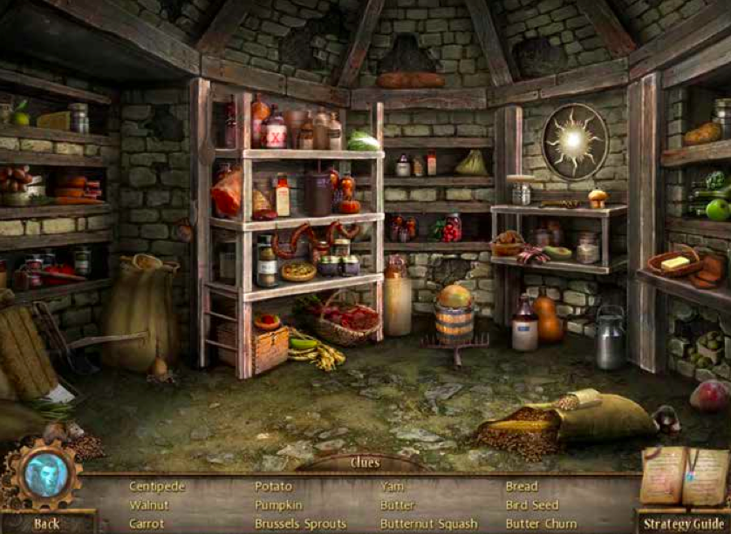
Screenshot taken from Beauty and the Beast Mystery Legends

Slide 21

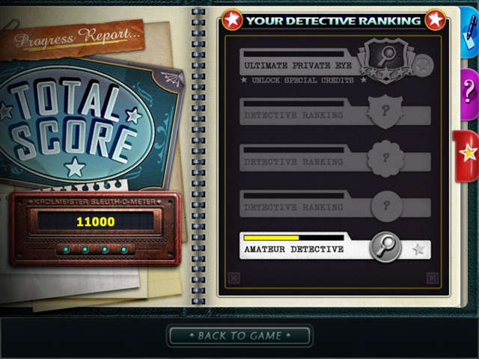
Female students
Male students
Beauty and the Beast Mystery
Grim Tales the Legacy
Notes:
It is also necessary to take your students’ interests into consideration. Working primarily at a women’s college, I tend to look for games that have a fantasy or romantic element in them because these are story
Lines that consistently interest my students.
Our female students were excited to play this game and thought the story was entertaining. I am not sure how interesting game would be for a middle-aged group of men or women in other cultural settings.
For male students, I would definitely choose something different, maybe with more action and less romance.
Picturelarin altina yaz ilkine fantasy and romantic , for men more action and less romantic
You want to make sure that the game would be interesting for your group of students. One game might be great for one group, but disastrously with another.

Slide 22
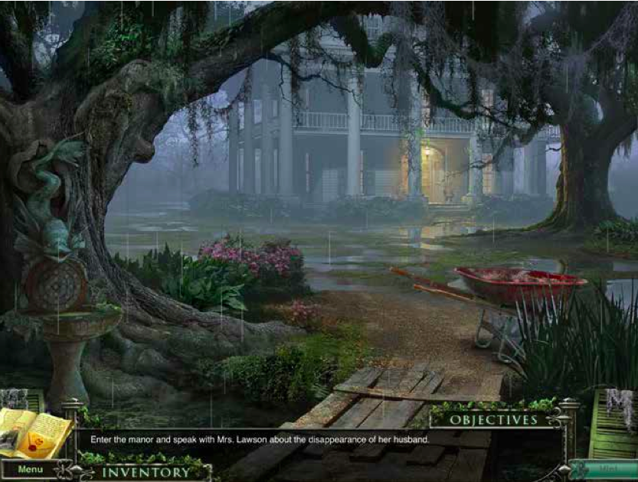
Screenshot taken from the 13th Skull

Slide 23
Research Questions?
Does playing video game improve Vocabulary knowledge?
Does playing video game help to improve English?

Slide 24
Methodology
Lower-level foundation students
33 students
Pre-game Vocabulary quiz
Post-game Vocabulary quiz
Survey
Notes:
It was the first time after two years of teaching in the foundations programme that the students didn’t want to take a break. Not one of the 22 students turned away from their computers for their computers for their 10 minute break.
One group took notes while the other simply played the game. After they finished, they were given a vocabulary test. Both groups learned new words due to playing the game.

Slide 25
Methodology
Lower-level foundation students
33 students
Pre-game Vocabulary quiz
Post-game Vocabulary quiz
Survey
Notes:
It was the first time after two years of teaching in the foundations programme that the students didn’t want to take a break. Not one of the 22 students turned away from their computers for their computers for their 10 minute break.
One group took notes while the other simply played the game. After they finished, they were given a vocabulary test. Both groups learned new words due to playing the game.

Slide 26
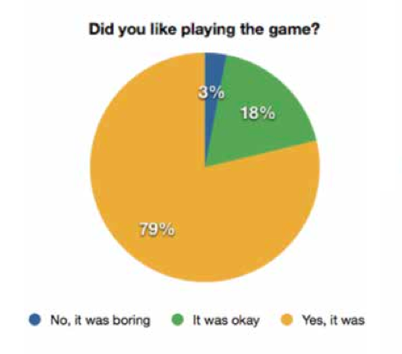
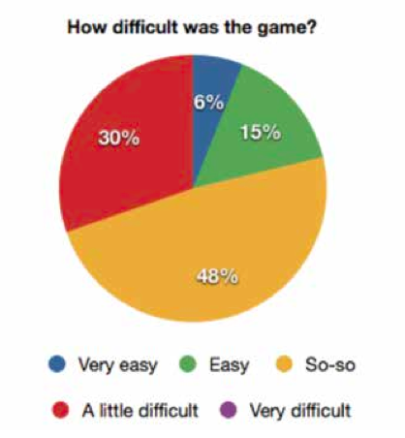
Results
Notes:
In the past year, several faculty at Ras Al Khaimah Women’s College have introduced adventure games to their students. The overall results were positive. The students are engaged and motivated to play the games.
The average score on the first quiz was 27% and increased to 61% on the second quiz. The students improved their vocabulary knowledge by %34 some the students even received a 100% on the quiz.

Slide 27
Reference
Barab, S. A., Gresalfi, M. S., & Ingram-Goble, A. (2010). Transformational play: using games to position person, content, and context. Educational Researcher, 39(7), 525–536.
Bronstring, M. (2012). What are adventure games? Retrieved from http://www. adventuregamers.com/articles/ view/17547
Chen, H. H. and Yang, T. C. (2013). The impact of adventure video games on foreign language learning and the perceptions of learners. Interactive Learning Environments, 21(2), 129-141.
Whittaker, S. (2013). Educational Use of Video Games in the ESL Classroom. UAE Journal of Education Technology and eLearning. Retrieved from http://ejournal.hct.ac.ae/wp-content/uploads/ 2013_Article01.pdf

Slide 28
Discussion Points
Analysis of Instructional Gaming and ESL Learners

