Slide 1


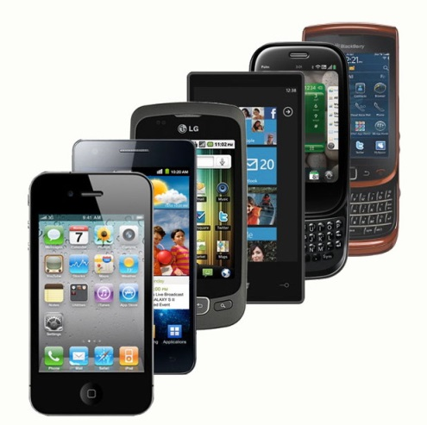

Bridging the Digital Gap:
A Conversation on Uniting BYOD and Instruction in the Higher Education Classroom
with
Juel Smith, Kelli Murphy-Godfrey
& Bekir Mugayitoglu
Notes:
15 minute discussion.

Slide 2
ESSENTIAL QUESTION:
How can we harness BYOD to engage our learners?

Slide 3
Assessing our Audience
Please take this short quiz
www.tinyurl.com/CCAC-BYOD

Slide 4

Join the Conversation
.com/CCAC-BYOD

Slide 5
“Digital technologies such as computers, mobile devices, digital media creation and distribution tools, video games and social networking sites are transforming how we think about schooling and learning.” Collins & Halverson. (2010)
Notes:
Are we, as educators, resisting the change? Let’s take for instance the state of the weather this season and how it has wrecked havoc on our school calendars, especially K-12. If educators incorporating more of a hybrid learning approach, learning might not have had so many interruptions. It could be reflected in the 24/7 accessibility to information which could be harnessed towards reflection or learning time.

Slide 6
“The consumerization of technology is setting a new standard whereby students, faculty, and staff bring their own devices, software, apps and cloud-based technology to create a personal computing environment.” Dahlstorm & diFilipo. (2013)
Notes:
Does a digital divide still exist? Can we stop the flood of devices that have infiltrated our lives both personally and professionally? We can arguably state that snail mail, checkbooks, landlines and watches alarm clocks are heading beyond their heydays. Can we really hold back on technology for our traditional classrooms?

Slide 7
What is BYOD?

Slide 8
BYOD DEFINITION:
Mobile devices which are OWNED by the individual and NOT the organization.
Notes:
This definition is my own.

Slide 9
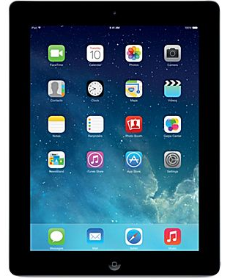
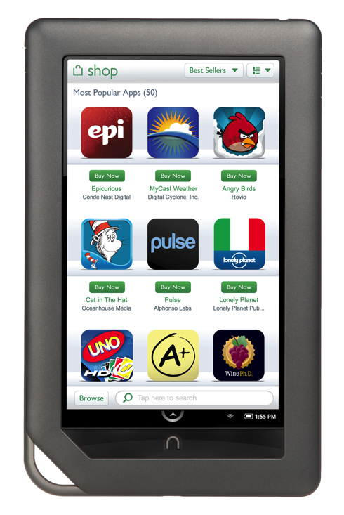
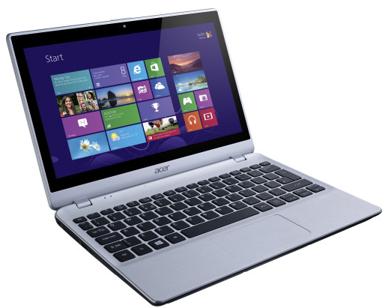
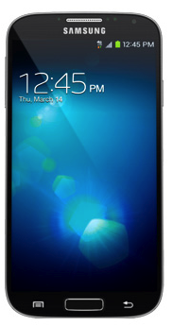
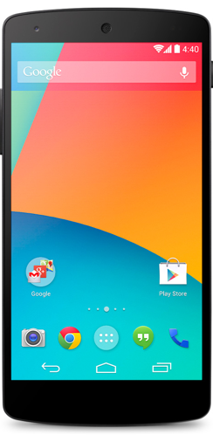
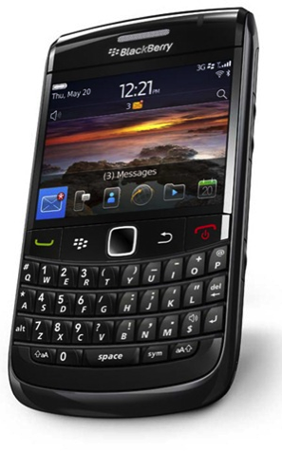
BYOD TYPES:
Also known as BYOE
“Bring Your Own Equipment”
Notes:
The digital landscape changes all the time. We cannot be productive to the device but rather the instructional methods to allow for the flexibility for growth.

Slide 10
Consumerization of technology
Affordable
Easy-to-use
Readily accessible technologies

Slide 11
The consumer market increasingly allows users to own and manage a long list of technologies.
According to the Gartner estimates:
Sold by the end of 2012 Smartphone ownership among undergraduate students

Slide 12
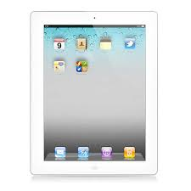
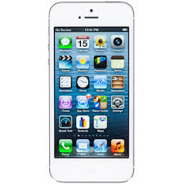
Adults and Undergraduates owning devices
46%
ADULTS own a smartphone
19%
ADULTS own an iPad or other tablet
15%
UNDERGRADUATES own an iPad or other tablet
62%
UNDERGRADUATES own a smartphone

Slide 13
IT leaders estimate the portion of employees “BYODing” for work-related purposes

Slide 14

Who are YOUR students?
Notes:
We had an opportunity to not just fix things, but to get the infrastructure ready for the future.
Growing supply of smartphones, tables and notebooks, but BYOD is growing?
Campus should require a lot more than just welcoming outside devices.
In fall 2012, Rowan-Cabarrus Community College (RCCC) formalized its BYOD plan by requiring students in its nursing program to bring their own devices.

Slide 15
Moving Forward or Pushing Back
19th Century
21st
Century
Notes:
85 percent of educational institutions allow students, teachers and faculty to use personal devices on school networks.
This is a huge opportunity for professors and students to engage in new learning styles.
Putting technology in students’ hands is transforming the educational experience.
BYOD is fueling the transition as educations move from traditional lecture-based instructions to new models of learning, teaching and collaboration.

Slide 16
Personal Experiences
A Student’s Perspective
Notes:
When I was undergraduate student 7 years ago in Turkey, instructions were traditional lecture-based. BYOD was not welcoming and requiring in the class. I saw once one of my classmates brought her laptop to the class.
There are several reasons even though it was not welcoming and requiring, the economical difficulties were effecting to buy laptops. In particular, smartphones, ipads, laptops are double price of American price.
After I arrived America, I have been English as a second language program at Duquesne University, took prerequisite courses with undergraduate students, I took graduate courses with master’s students, and am taking doctoral courses with doctoral students.
What it is interesting, I took so many various classes with different backgrounds and cultures.
Economical factors, when I was at community college, I took math and business classes, there were just 5 students out of 25 were bringing their own devices. Graduate school at private university the number of students are increasing to use devices. Comparing the salary and supporting by their family, the loan effects whether they bring their device or not.
Department background factors, I took statistics, American politics, Theory and practice teaching English, Introduction to International Relations, Statistics, Interactive design. What stood out is that more tech related majors like Computer Science, Instructional technology, Graphic design are encouraging and welcoming bring your own device, but social science majors public policy, teaching English, international relations are not welcoming and requiring, but also discouraging. I remember once in American politics class my instructor was staring at me while I was using I pad in the class.

Slide 17
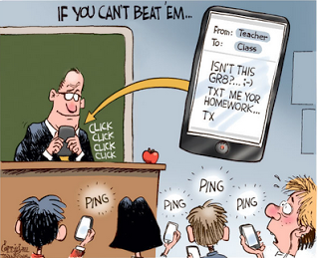
The Instructor and BYOD:
Friend or foe

Slide 18
The Generational Gap
Growing up Digital
Notes:
Age factors, What I observed is interesting, old generation is using their device less than young generations use their own device. Digital native who was born with technology is confortable, familiar, and picking up everything by device, but digital immigrants are not used to use devices, but pencil-paper traditional classroom.

Slide 19
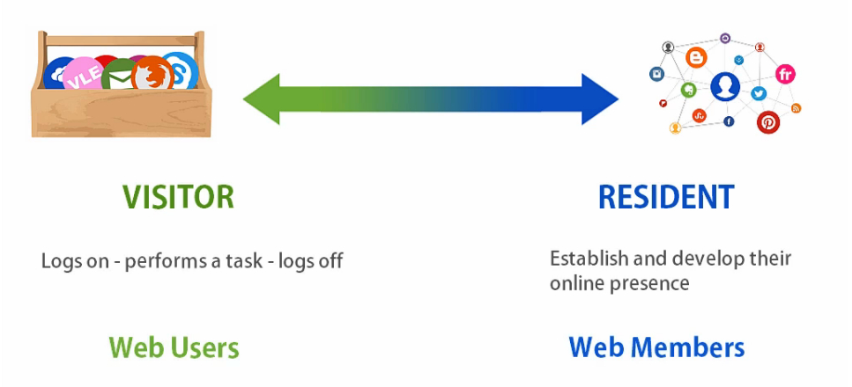
Contributes to online content
Sees web as a network
Has an online profile
Seeks content online at
first instance
Only goes online if necessary
Web is seen as a tool
Does not build an online portfolio
No participation in online culture
http://tinyurl.com/khcjmk4
http://tinyurl.com/pnauns7

Slide 20














Slide 21
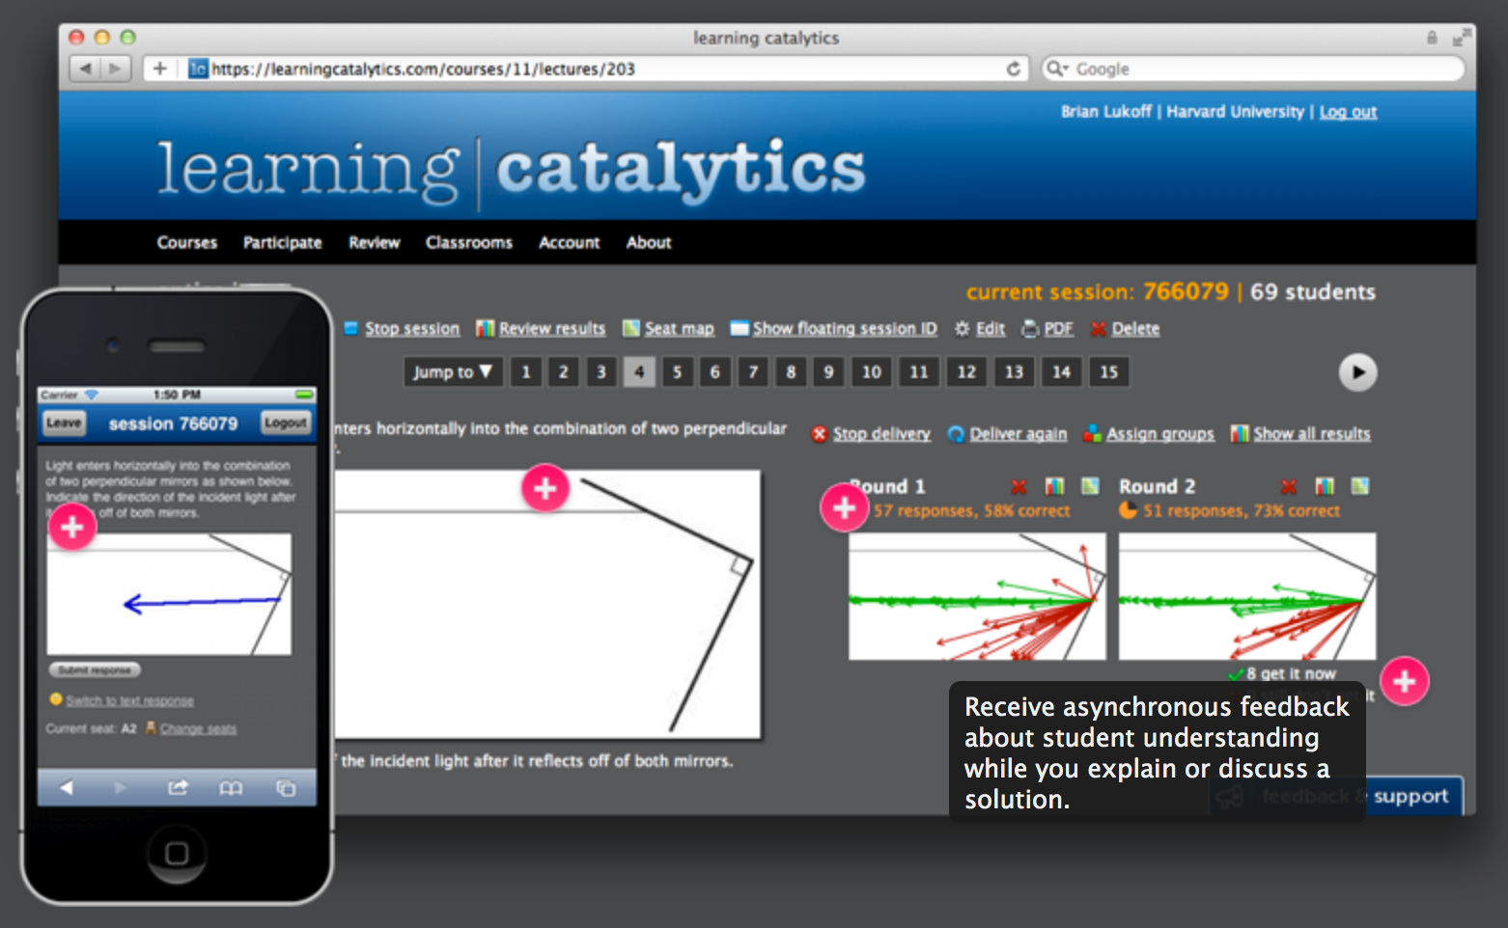
By Pearson PLC
Provides REAL TIME data on your students using Open-Ended tasks to probe understanding.
Notes:
Juel

Slide 22
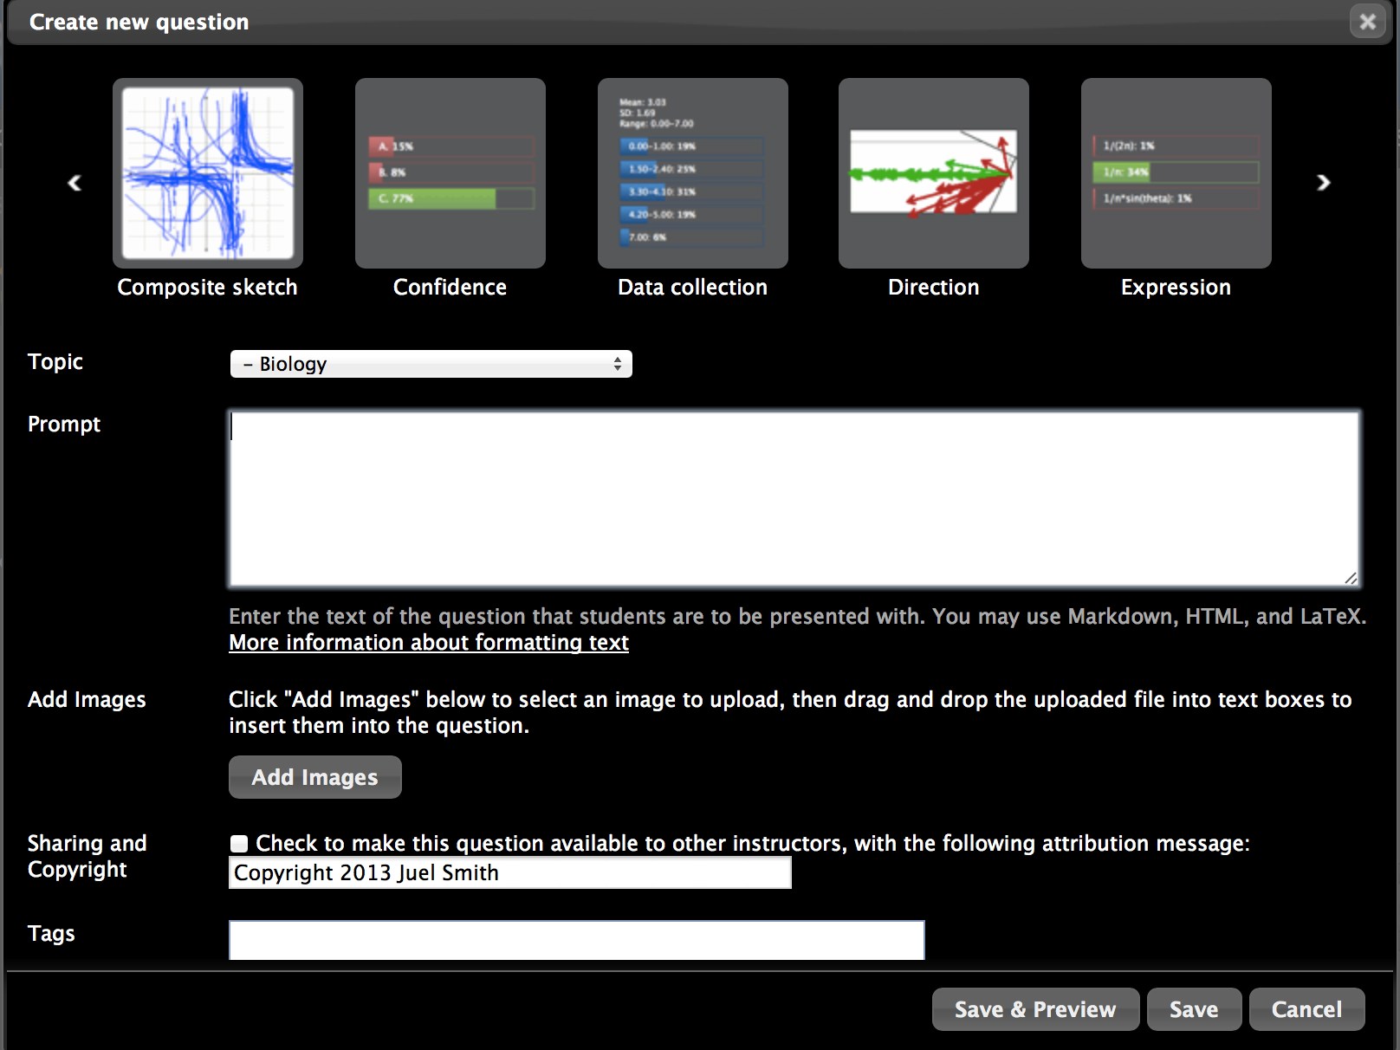
Teacher setups up the questions that targets areas for review.
Notes:
Juel

Slide 23
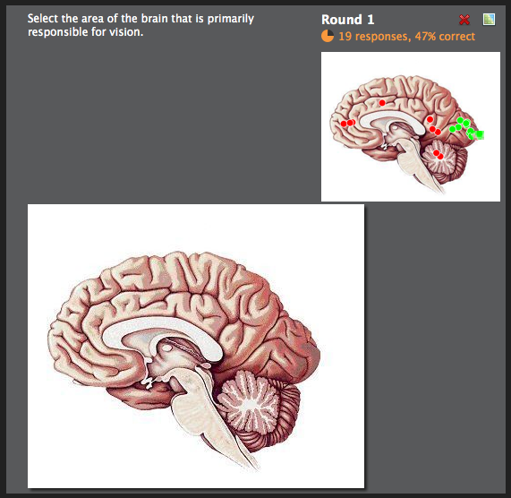
Sample Question
Response Data for Teacher
Notes:
Juel

Slide 24
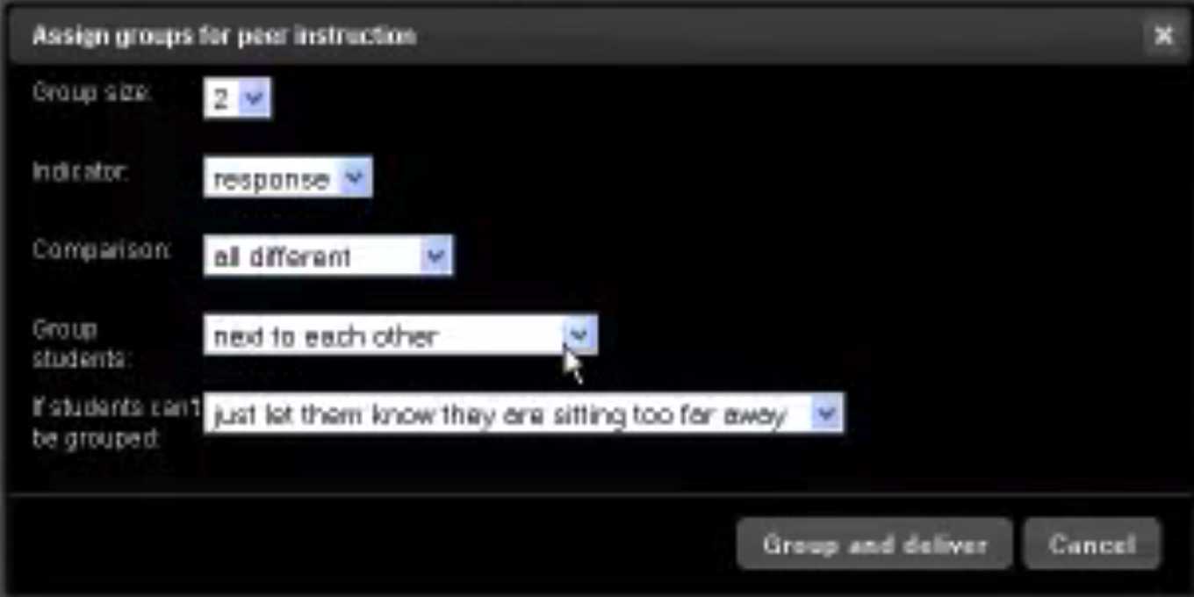
Student Groupings
Assign groups for peer instruction
x
Group size
2
Indicator
response
Comparison
all different
Group students
next to each other
If students can’t be grouped
Just let them know they are sitting too far away
Group and deliver
Cancel
developed from data.
Notes:
Juel

Slide 25

YOUR _{TURN}
Join the conversation
.com/CCAC-BYOD

Slide 26
What benefits does BYOD present to both the instructor and student?
FORUM

Slide 27
What are some barriers to the incorporation of technology into the instruction.
FORUM

Slide 28

What have been the BARRIERS?
Focus
Support
Time
Constraints
Lack of
technology
Visitor versus Resident
Training

Slide 29
How does the incorporation of BYOD affect our instructional practices?
FORUM

Slide 30
How distracted are BYOD learners?
FORUM

Slide 31

THANK YOU!
View BIOS, Presentation, &
TodaysMeet transcript at:
www.BringYourOwnD.wordpress.com

